Slide 1


Sunderland College, November 2025
Billy Clark
billy.clark@northumbria.ac.uk

Slide 2

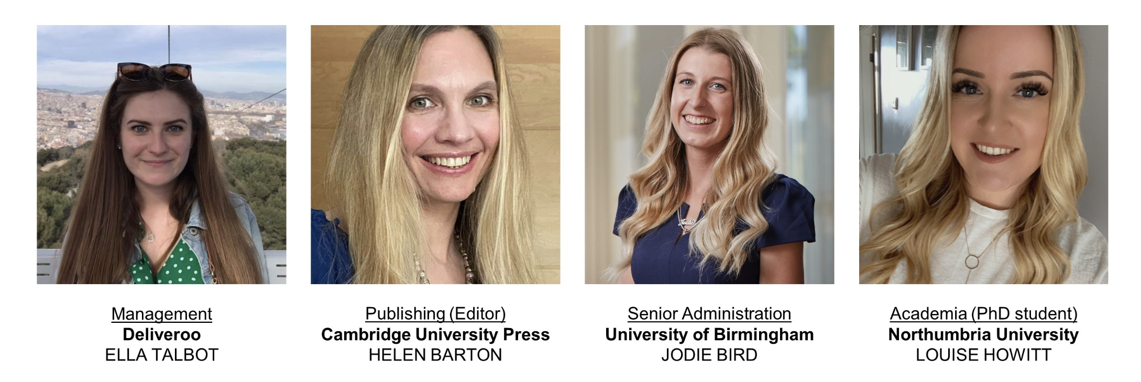

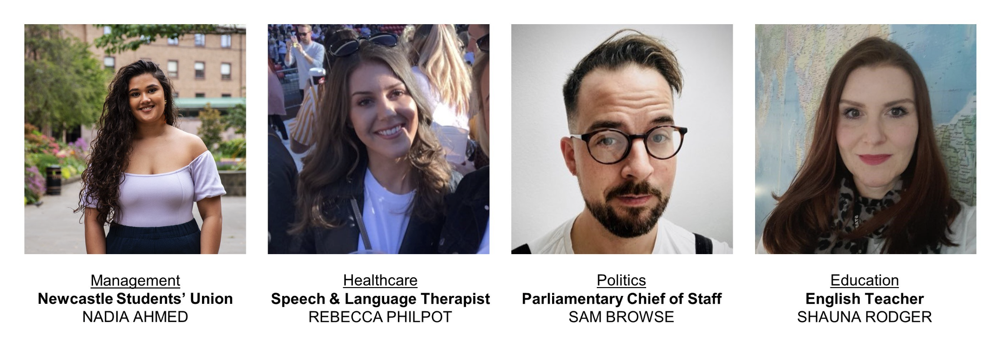

Slide 3

https://northumbriaenglish.org/careers-and-english-degrees/
https://sway.cloud.microsoft/EeLevTG6pfEFuhll

Slide 4
Say anything that occurs to you about this passage:
Lok was running as fast as he could. His head was down and he carried his thorn bush horizontally for balance and smacked the drifts of vivid buds aside with his free hand. Liku rode him laughing, one hand clutched in the chestnut curls that lay on his neck and down his spine, the other holding the little Oa tucked under his chin. Lok’s feet were clever. They saw. They threw him round the displayed roots of the beeches, leapt when a puddle of water lay across the trail. Liku beat his belly with her feet.

Slide 5
What has changed in this version?
Mr. Lok was running as fast as he could. His head was down and he carried his thorn bush horizontally for balance and smacked the drifts of vivid buds aside with his free hand. Miss Liku rode him laughing, one hand clutched in the chestnut curls that lay on his neck and down his spine, the other holding the little Oa tucked under his chin. Mr. Lok’s feet were clever. They saw. They threw him round the displayed roots of the beeches, leapt when a puddle of water lay across the trail. Liku beat his belly with her feet.

Slide 6
What other changes might you make?
Mr. Lok was running as fast as he could. His head was down and he carried his thorn bush horizontally for balance and smacked the drifts of vivid buds aside with his free hand. Miss Liku rode him laughing, one hand clutched in the chestnut curls that lay on his neck and down his spine, the other holding the little Oa tucked under his chin. Mr. Lok’s feet were clever. They saw. They threw him round the displayed roots of the beeches, leapt when a puddle of water lay across the trail. Liku beat his belly with her feet.

Slide 7
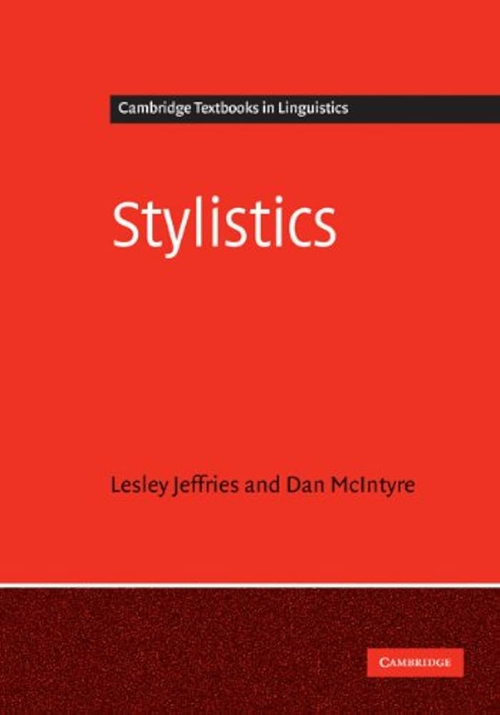

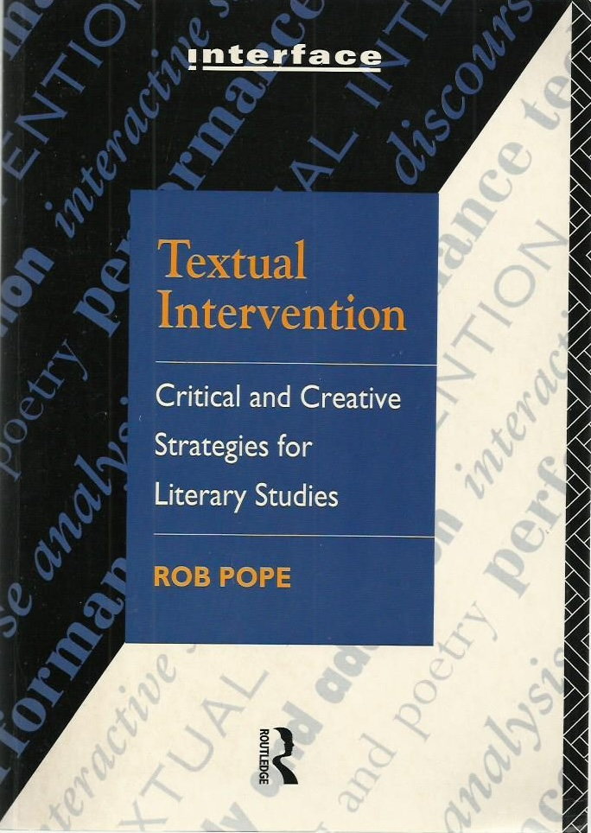
For more ideas on changing texts:

Slide 8

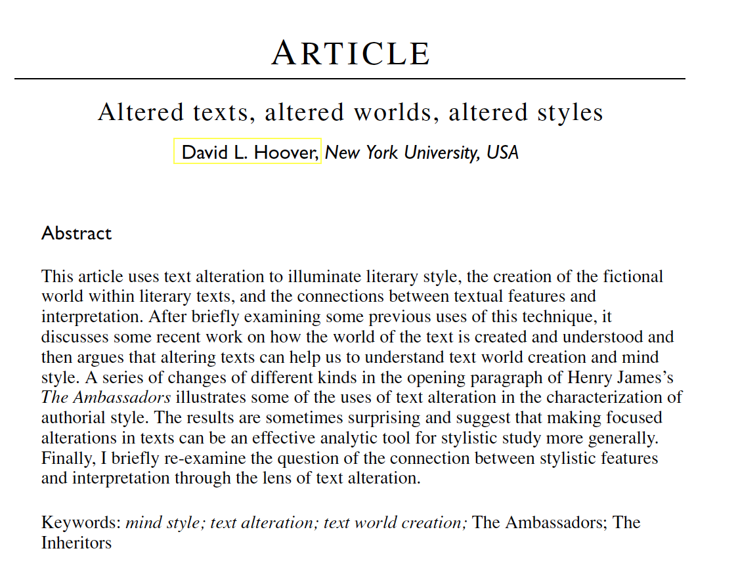
Hoover, David. 2004. Altered texts, altered worlds, altered styles. Language and Literature 13.2: 99-118.

Slide 9
Another example:
Can you help me move the desks in the seminar room?
No

Slide 10
How might you change either of these?
Can you help me move the desks in the seminar room?
No

Slide 11
What are the effects of the changes you made?
Can you help me move the desks in the seminar room?
No

Slide 12
What skills do you think you demonstrated in talking about these examples?

Slide 13
What other skills do you think you might develop in studying English?

Slide 14
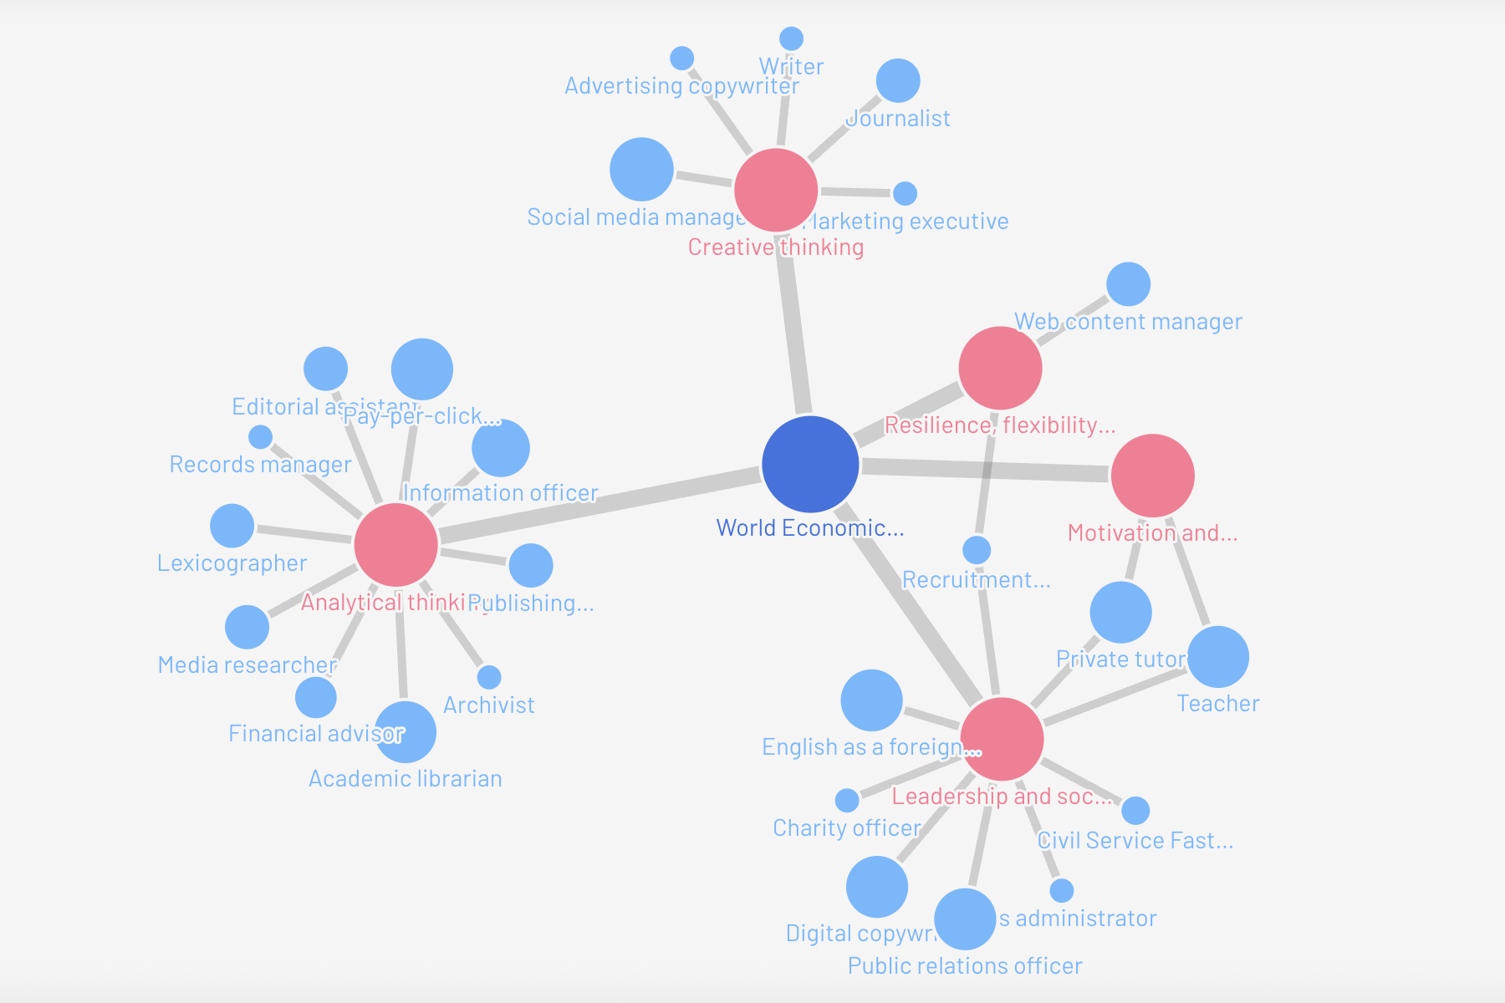

Slide 15

https://universityenglish.ac.uk/english-creates-futures/

Slide 16
Some of my thoughts
understanding language
communication
contexts
arguments
complex situations
complex data
developing projects
planning
group work
independent work

Slide 17
Some of my thoughts
understanding situations
analysing
reflecting
thinking ahead
being proactive
creativity
critical thinking
developing and testing theories
mindreading

Slide 18
An example
You’re about to be interviewed for a job
What do you do to prepare?
What do you aim to do during the interview?
How does any of this relate to what you’ve done when studying English?

Slide 19
The interview
What will the first question be?
What else will they ask?
How will you walk into the room?
How long do you speak for?

Slide 20

https://universityenglish.ac.uk/englishcreates/

Slide 21


Slide 22
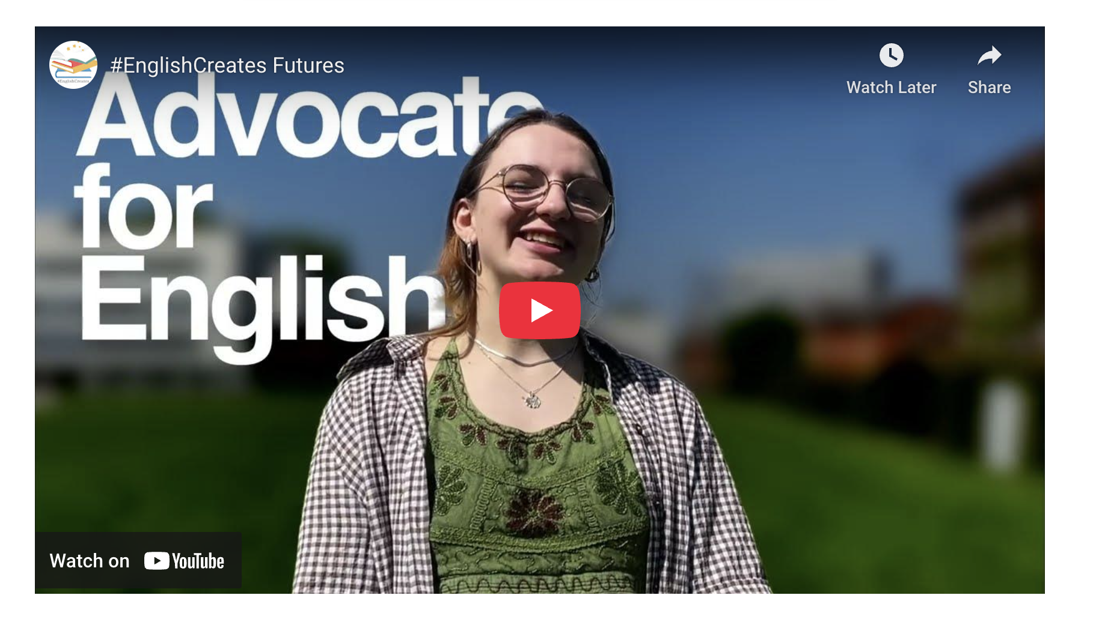

Slide 23

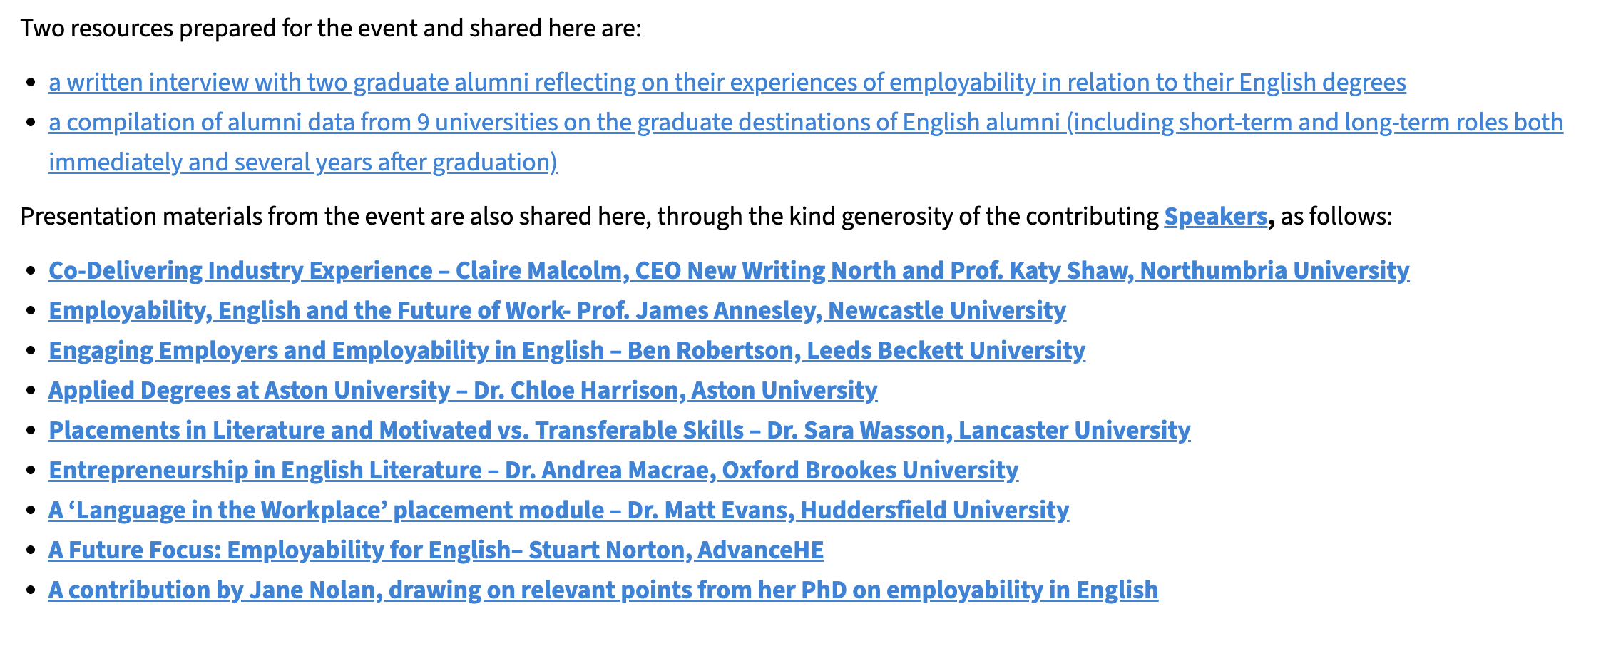
https://englishassociation.ac.uk/action-on-employability-in-english/

Slide 24
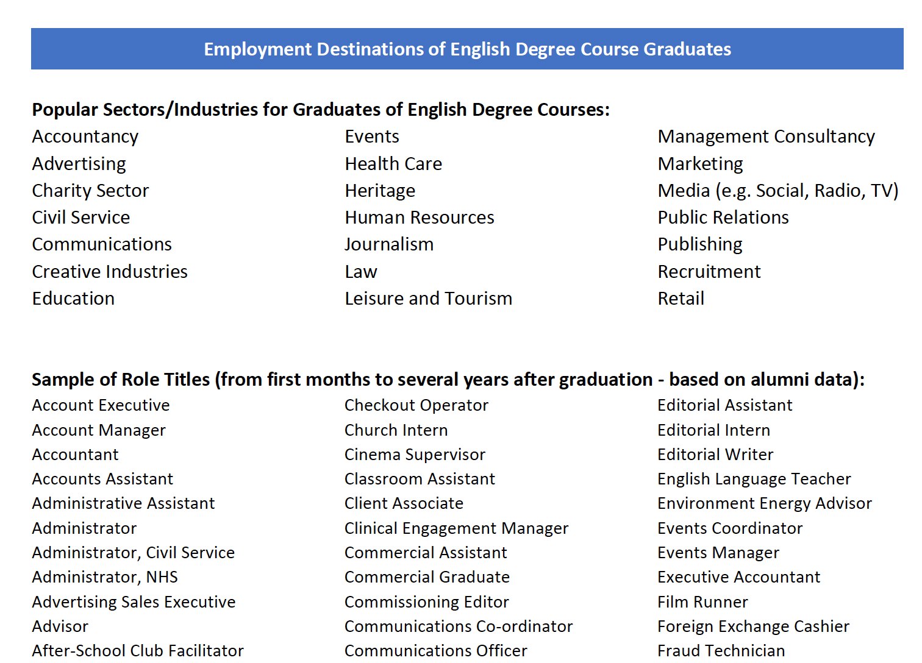

Slide 25
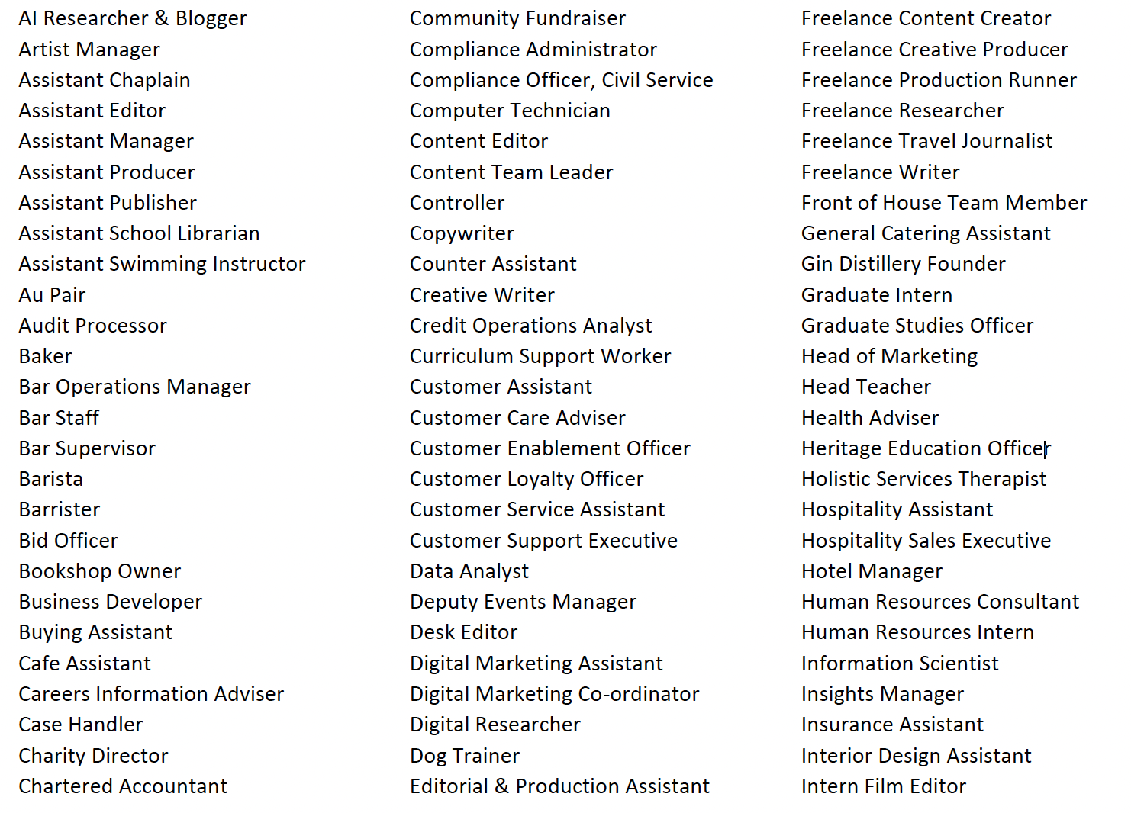

Slide 26
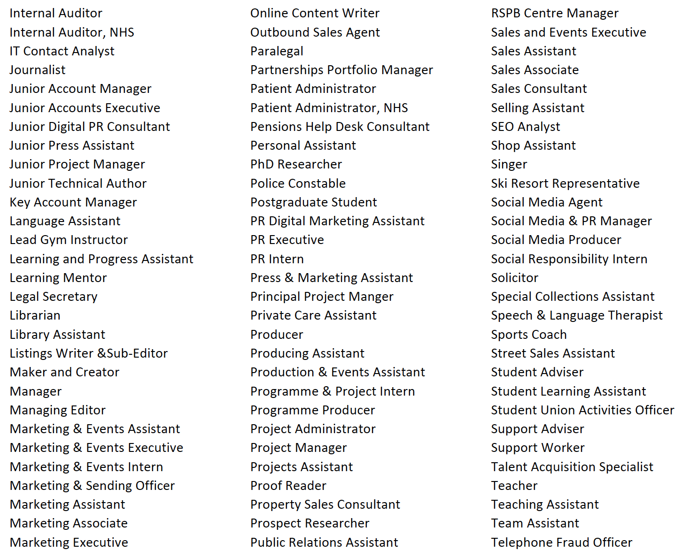

Slide 27
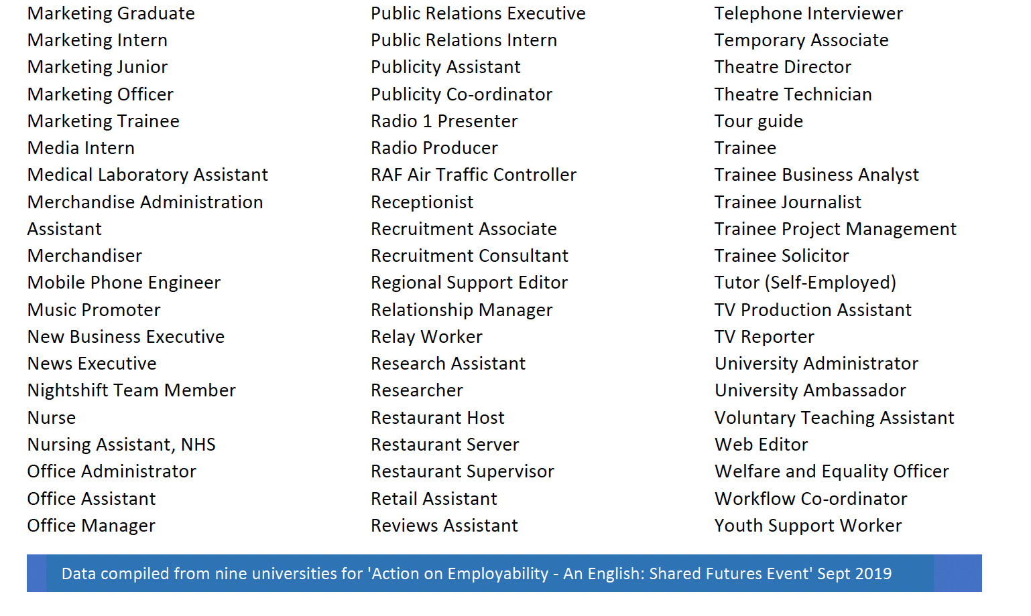

Slide 28
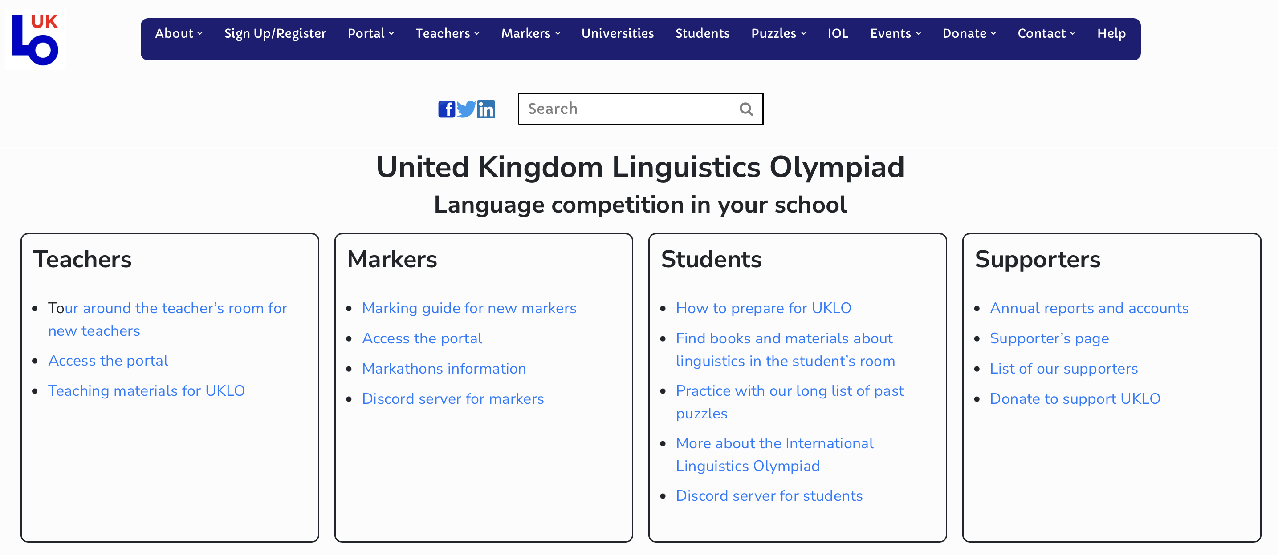
https://www.uklo.org

Slide 29





Slide 30


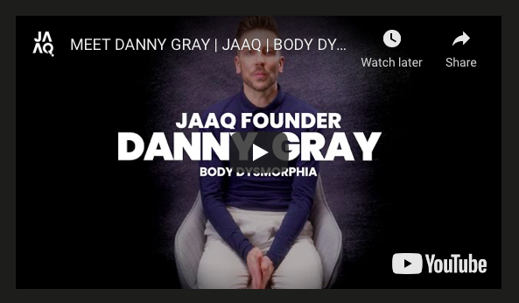

Slide 31

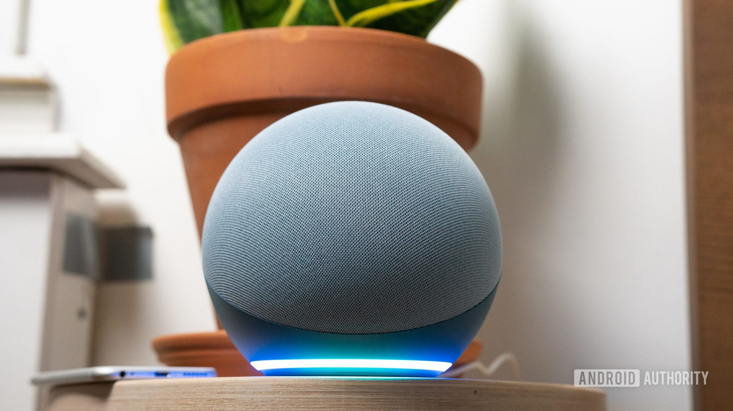
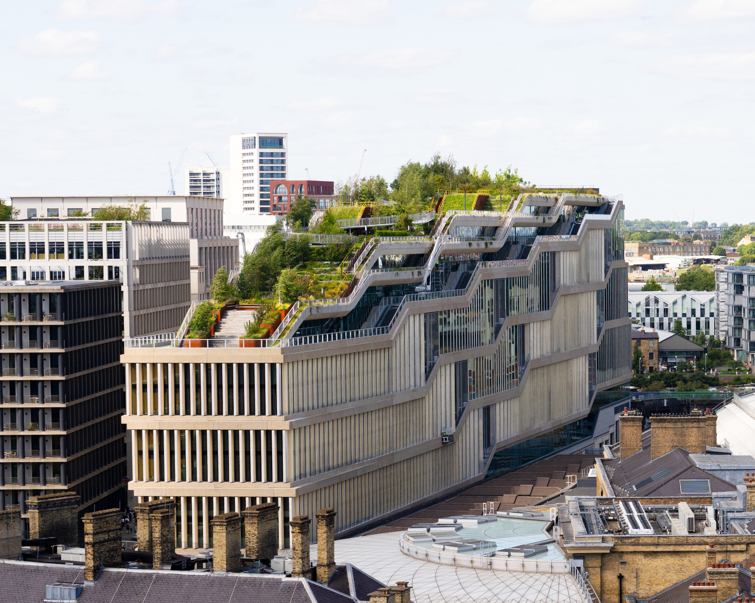

Slide 32
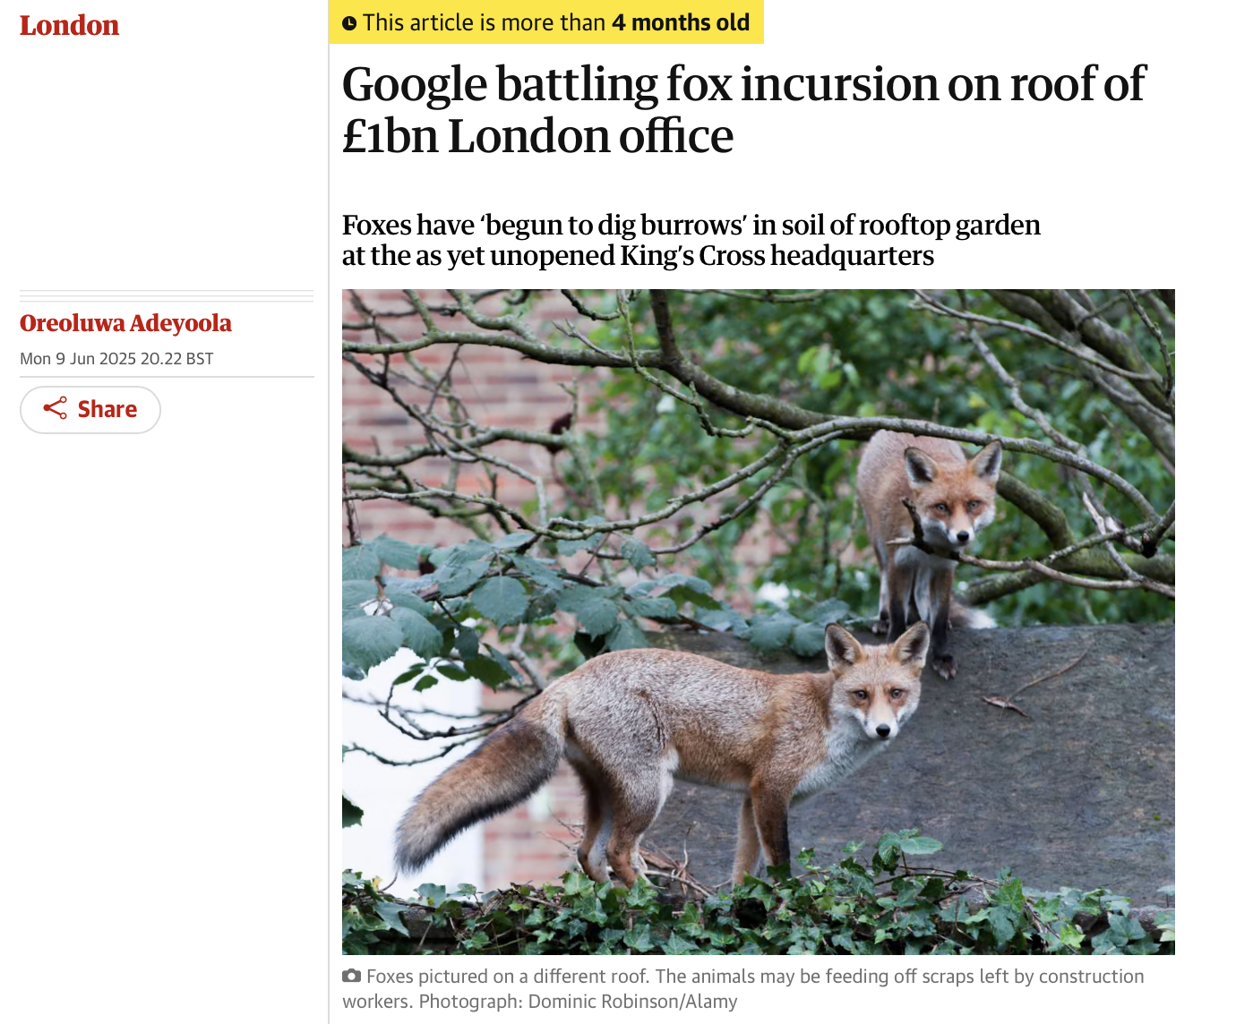
https://www.theguardian.com/uk-news/2025/jun/09/google-foxes-roof-london-kings-cross-office

Slide 33
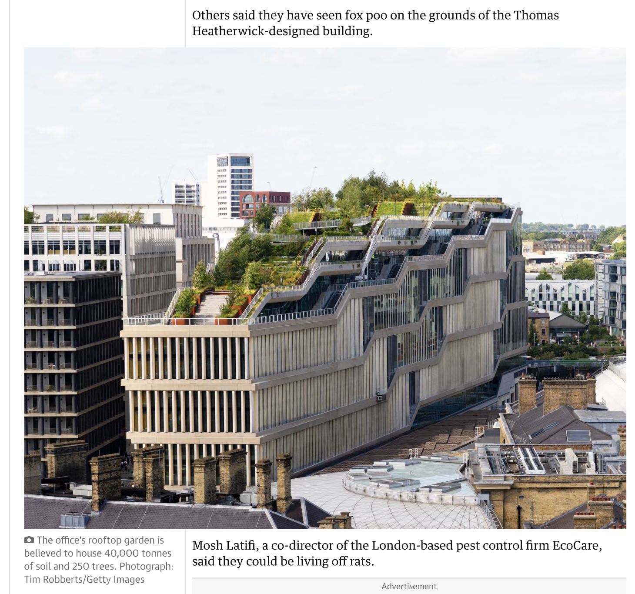

Slide 34
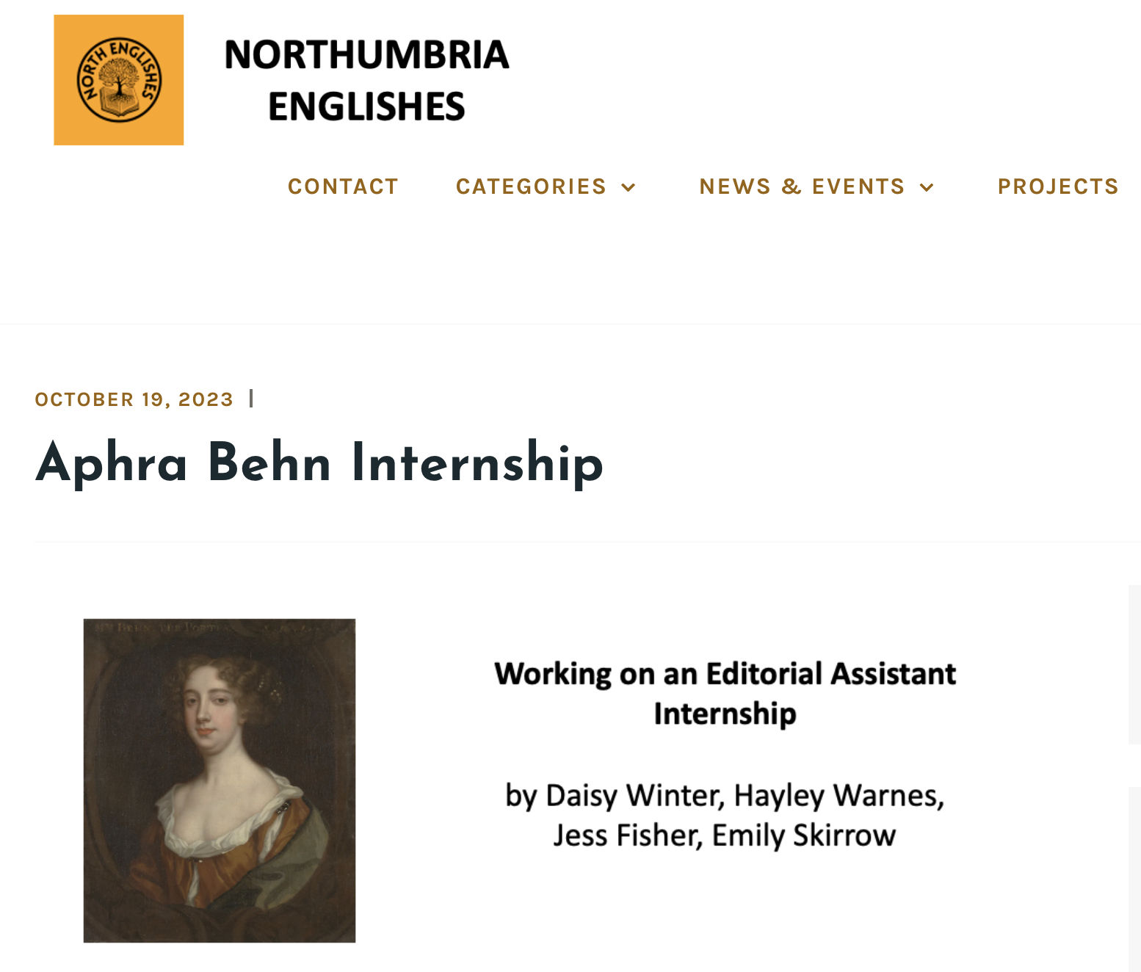



Slide 35
Other things to think about
think critically about everything
talk about everything to everyone
find out everything you can relevant to your plans

Slide 36
Other things to think about
think critically about everything
talk about everything to everyone
find out everything you can relevant to your plans
think critically about these too

Slide 37
Thanks!
Email me if you have any questions, comments or other thoughts:
billy.clark@northumbria.ac.uk

