Slide 1



MLA 2026 Special Session
‘Producing and Evaluating Style’
Pragmatics and Style
Billy Clark
billy.clark@northumbria.ac.uk
Notes:
Welcome to the session. Billy then Anne then Tony. Questions at the end

Slide 2
Pragmatics and Style
More information on this session:
https://producingandevaluatingstyle.mla.hcommons.org/
Discussion paper on Producing and Evaluating Style project:
https://northumbriaenglish.org/wp-content/uploads/2026/01/billy-clark-discussion-paper-producing-and-evaluating-style-1.pdf
Thanks for support from the Leverhulme Trust (MRF-2024-043)
Notes:
Session inspired by this project which I’ll tell you a bit about first. Follow links for more info

Slide 3
Pragmatics
about how we communicate and understand each other
how we decide which words to use, and what other things to do, while communicating
how we work out what someone intends to communicate by what they say and do
how meanings emerge and are adjusted during interaction

Slide 4
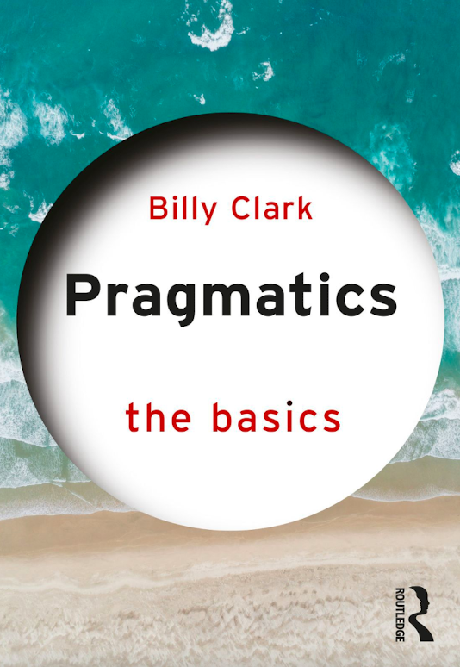
A narrower sense
“This book focuses on pragmatics understood as being about how we work out (or ‘infer’) what to say, write, sign (in sign languages), and do when communicating, and how we work out (‘infer’) what others are intending to communicate to us

Slide 5
Also about showing
we make pragmatic inferences when we recognise that something is intended to communicate something
this is sometimes termed ‘ostension’
we produce ostensive stimuli to communicate
we look for particular kinds of interpretations when we recognise ostension

Slide 6
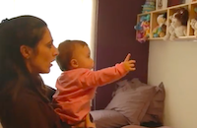

Pragmatics without language
Tomasello
Tomasello

Slide 7

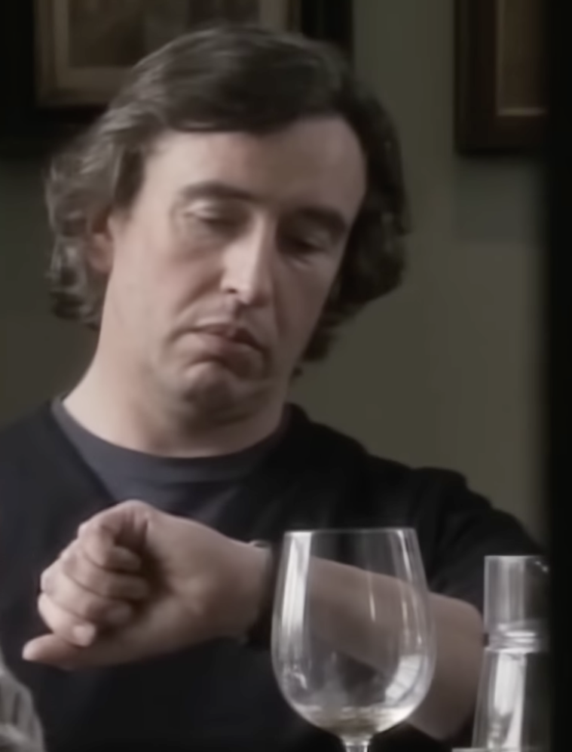

Slide 8
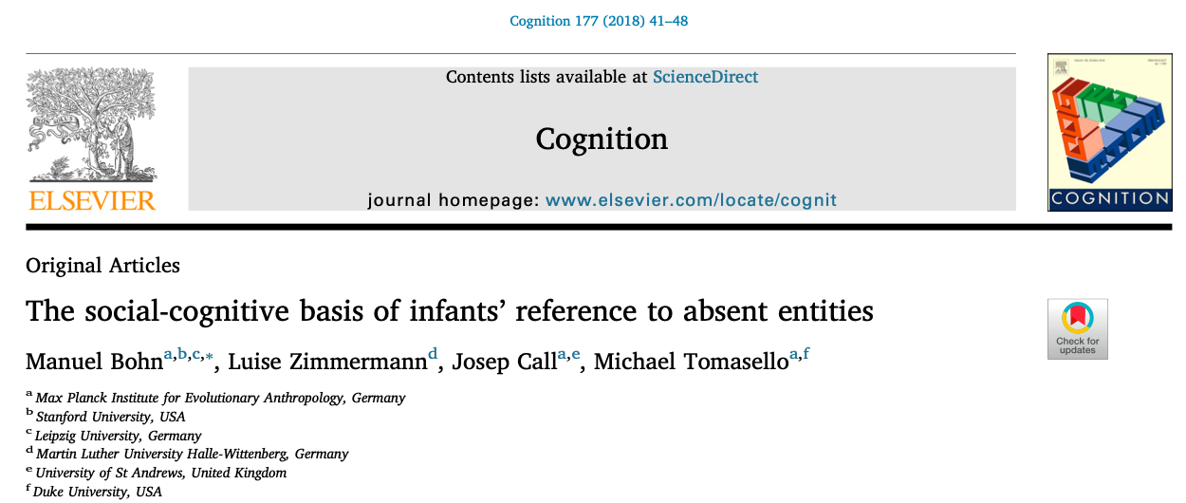
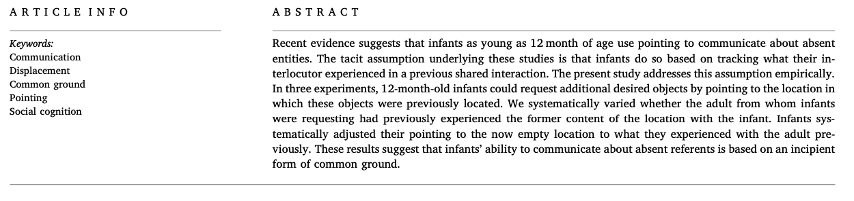
https://manuelbohn.github.io/paper/Bohn_Zimmermann_Call_Tomasello_common_ground_displacement_infants.pdf

Slide 9
‘Simple’ pragmatics
Can you help me with this?
I’m busy
Billy said: Billy is busy
Billy implicated: Billy can’t help Sarah with her analysis

Slide 10
One kind of analysis (‘Gricean’)
Sarah inferred (‘worked out’) that Billy can’t help with her analysis
because she assumes that what he said should be informative and relevant
it would not be informative and relevant unless she inferred something like this

Slide 11
But . . .
pragmatics is involved in all aspects of communication
including direct communication (what we ‘say’)
and nonverbal communication

Slide 12
But . . .
we communicate more than one or two simple propositions
there is lots of indeterminacy
what about production?
what about evaluation?
do we really infer like this?

Slide 13
Production
many pragmaticists mention production
few make detailed claims about how it works

Slide 14
Production
“He has said that p; there is no reason to suppose that he is not observing the maxims, or at least the Cooperative Principle; he could not be doing this unless he thought that q; he knows (and knows that I know that he knows) that I can see that the supposition that he thinks that q is required; he has done nothing to stop me thinking that q; he intends me to think, or is at least willing to allow me to think, that q; and so he has implicated that q.”
(Grice, H. Paul. 1975: 50)

Slide 15
Production
many pragmaticists mention production
few make detailed claims about how it works
Kecskés (2013; Kecskés and Fhang 2009): ‘dynamic model’; ‘egocentrism’ as well as Gricean inference
Park (2023; Park and Clark 2022): ‘relevance-guided production heuristic’ (shares some properties with comprehension)

Slide 16
Evaluation
even less work on this
Clark (2014) on literary/aesthetic evaluation:
ease of representation
relevance of effects
‘reward’ for effortful inferences
awareness of responses of others
positive attitudes to formal features and ‘skill’

Slide 17
Kinds of inference
Grice (2001): a ‘hard way’ and a ‘quick way’ to comprehend utterances
‘hard way’: explicit reasoning
‘quick way’: faster and more spontaneous

Slide 18
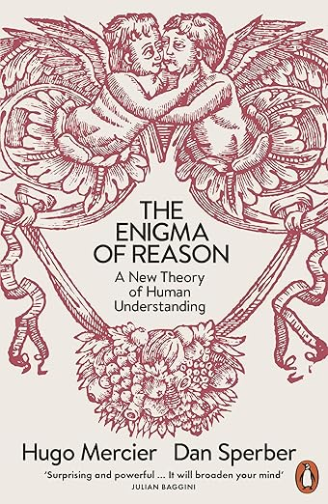
a new view of reasoning
‘interactionist’ (as opposed to ‘intellectualist’ view)
social function (to justify and explain)
‘intuitive inference’ which focuses on reasons
which are generated by unconscious processes

Slide 19
Intuitive inferences
‘conscious conclusions arrived at through unconscious processes’
‘the output of a great variety of inferential modules, the output of which is to some degree conscious while their operations remain unconscious’

Slide 20
Reflective conclusions
conclusions ‘accepted because of higher-order thinking (or “reflection”) about [them]’
‘A reflective conclusion may be an indirect output of a process of intuitive inference. The direct output of this process is an intuitive conclusion about reasons R1, R2, …, Rn for some conclusion . . . the indirect output is the reflective conclusion’

Slide 21
Why did you call the doctor?
Her temperature was a hundred and two

Slide 22
‘Reflective conclusions’
conclusions ‘accepted because of higher-order thinking (or “reflection”) about [them]’
‘A reflective conclusion may be an indirect output of a process of intuitive inference. The direct output of this process is an intuitive conclusion about reasons R1, R2, …, Rn for some conclusion . . . the indirect output is the reflective conclusion’

Slide 23
To develop a fuller account
account for production, interpretation and evaluation
communication as interaction
production, interpretation and evaluation also interacting
unconscious processes
extending over time and space

Slide 24
A specific idea
production, interpretation and evaluation all involve focus on effects (experienced and imagined)

Slide 25
References
Clark, Billy, 2014. Before, during and after Chekhov: inference, literary interpretation and literary value. In Siobhan Chapman and Billy Clark (eds.) Pragmatic literary stylistics. Palgrave Macmillan: 55-69.
Grice, H. Paul. 1975. Logic and conversation. In Peter Cole and Jerry L. Morgan (eds.) Syntax and semantics, volume 3: speech acts. Academic Press: 41-58. Reprinted in Grice 1989: 22-40.
Grice, H. Paul. 1989. Studies in the way of words. Harvard University Press.
Grice, H. Paul. 2001. Aspects of reason. Clarendon Press.
Park, Kyu Hyun. 2023. Relevance theory and the pragmatics of production. PhD thesis, Northumbria University.
Park, Kyu Hyun, and Billy Clark. 2022. A relevance-focused production heuristic. Journal of Pragmatics 187: 176-185.
Sperber, Dan, and Deirdre Wilson. 1986 [second edition 1995]. Relevance: communication and cognition. Wiley-Blackwell.

