Slide 1


Stylistics Circle 18 June 2026
Producing and Evaluating Style
Billy Clark
billy.clark@northumbria.ac.uk

Slide 2
What might you say about this exchange?
Hi Bruce,
I’ll be away at a conference on Saturday,
Suzanne
_____________________________________________________________
From: Bruce <bruce@example.com>
To: Suzanne <suzanne@example.com>
Subject: Possible big favour
Hi Suzanne,
I’m sorry to ask at short notice but would you be able to help at the open day on Saturday?
I’ll be doing the subject talk and workshop but we need one more person to help at the stall.
Thanks and best wishes,
Bruce

Slide 3
What might you say about it with regard to pragmatics?
Hi Bruce,
I’ll be away at a conference on Saturday,
Suzanne
_____________________________________________________________
From: Bruce <bruce@example.com>
To: Suzanne <suzanne@example.com>
Subject: Possible big favour
Hi Suzanne,
I’m sorry to ask at short notice but would you be able to help at the open day on Saturday?
I’ll be doing the subject talk and workshop but we need one more person to help at the stall.
Thanks and best wishes,
Bruce

Slide 4
How much of what you said was about production?
How much was about evaluation?
How much was about interpretation?

Slide 5
Any thoughts to add now about production?
Hi Bruce,
I’ll be away at a conference on Saturday,
Suzanne
_____________________________________________________________
From: Bruce <bruce@example.com>
To: Suzanne <suzanne@example.com>
Subject: Possible big favour
Hi Suzanne,
I’m sorry to ask at short notice but would you be able to help at the open day on Saturday?
I’ll be doing the subject talk and workshop but we need one more person to help at the stall.
Thanks and best wishes,
Bruce

Slide 6
Any about evaluation?
Hi Bruce,
I’ll be away at a conference on Saturday,
Suzanne
_____________________________________________________________
From: Bruce <bruce@example.com>
To: Suzanne <suzanne@example.com>
Subject: Possible big favour
Hi Suzanne,
I’m sorry to ask at short notice but would you be able to help at the open day on Saturday?
I’ll be doing the subject talk and workshop but we need one more person to help at the stall.
Thanks and best wishes,
Bruce

Slide 7
Any about interpretation?
Hi Bruce,
I’ll be away at a conference on Saturday,
Suzanne
_____________________________________________________________
From: Bruce <bruce@example.com>
To: Suzanne <suzanne@example.com>
Subject: Possible big favour
Hi Suzanne,
I’m sorry to ask at short notice but would you be able to help at the open day on Saturday?
I’ll be doing the subject talk and workshop but we need one more person to help at the stall.
Thanks and best wishes,
Bruce

Slide 8
How ‘Gricean’ were you?
Hi Bruce,
I’ll be away at a conference on Saturday,
Suzanne
_____________________________________________________________
From: Bruce <bruce@example.com>
To: Suzanne <suzanne@example.com>
Subject: Possible big favour
Hi Suzanne,
I’m sorry to ask at short notice but would you be able to help at the open day on Saturday?
I’ll be doing the subject talk and workshop but we need one more person to help at the stall.
Thanks and best wishes,
Bruce

Slide 9
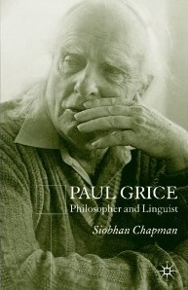
Gricean pragmatics
rational principles (‘maxims’) guiding communication
often seems to assume fairly explicit reasoning
focus on ‘implicatures’

Slide 10
Pragmatics generally
has focused mainly on interpretation
often seems to assume fairly explicit reasoning
but assumes broader scope for pragmatic principles
and more indeterminacy

Slide 11
This project aims to:
develop accounts of production and evaluation as well as interpretation
and of how they interact
with communication seen as dynamic and extending over space and time
and to say more about the kinds of processes involved

Slide 12
One idea
all pragmatic processes involve focusing on effects

Slide 13
Production involves:
consideration of imagined effects on addressees
evidence of effects from (interpretation of) behaviour of addressees

Slide 14
Interpretation involves:
consideration of imagined (by communicators) effects on addressees
evidence from (interpretation of) behaviour of communicators

Slide 15
Evaluation
consideration of effects on addressees (i.e. on self)
effects imagined by communicators
imagined effects on other addressees

Slide 16
What do you think?

Slide 17
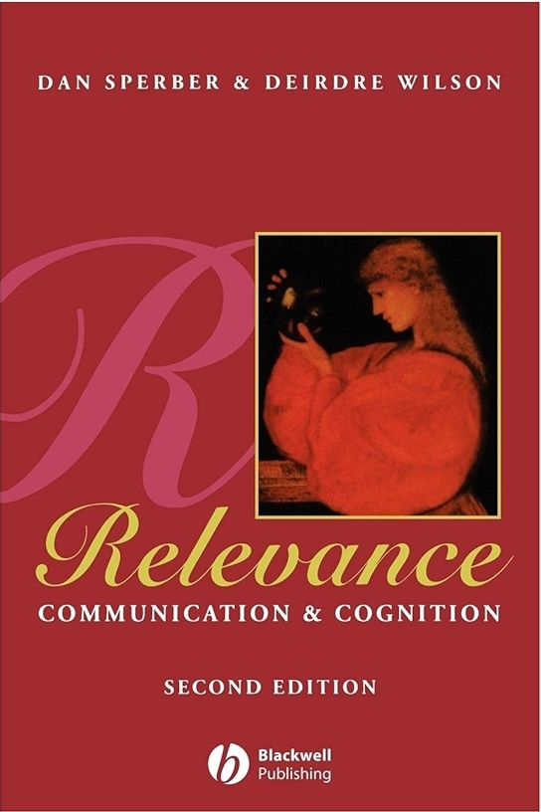
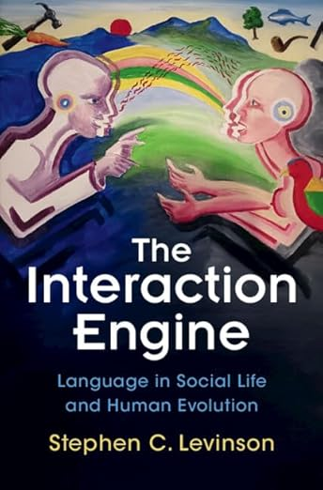
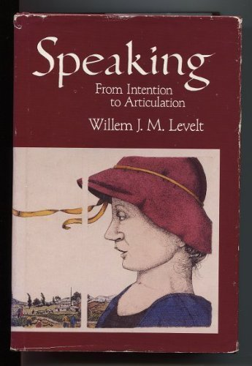
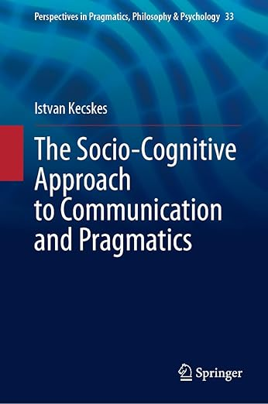

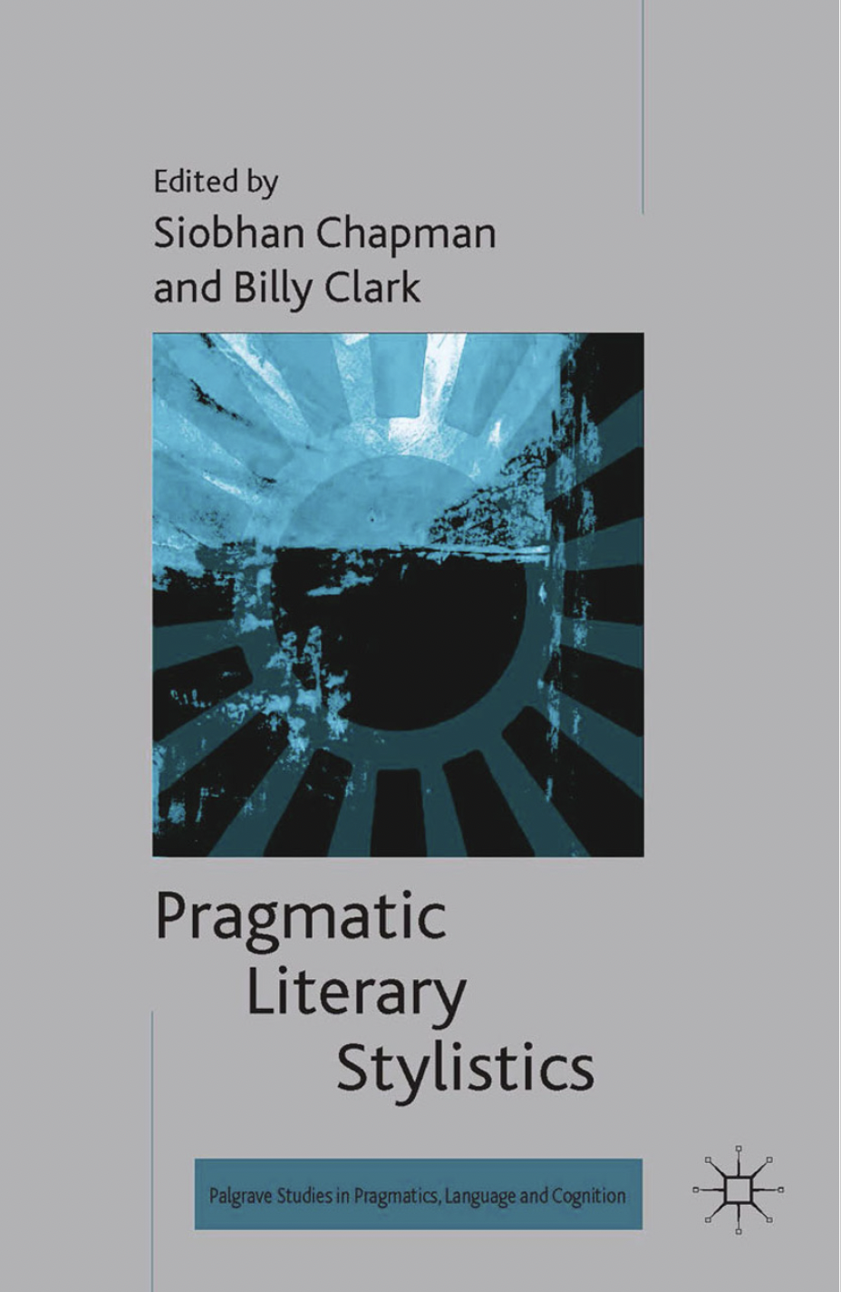

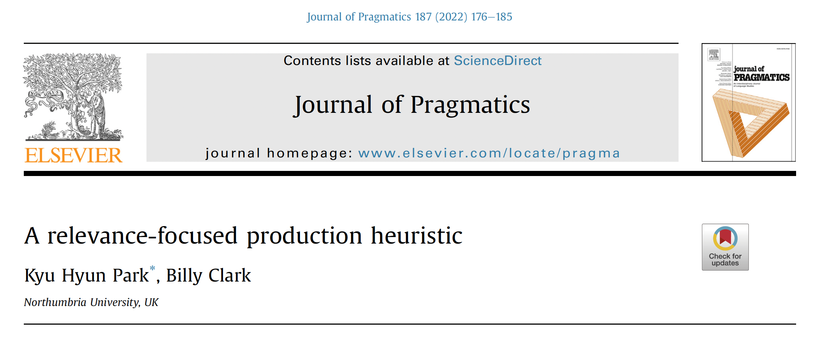
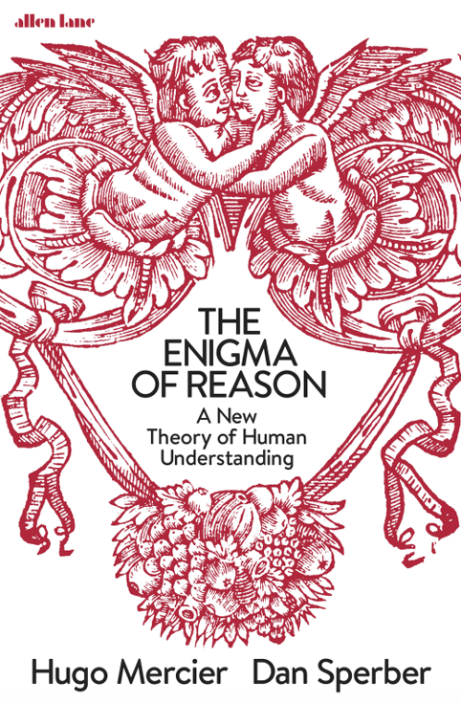
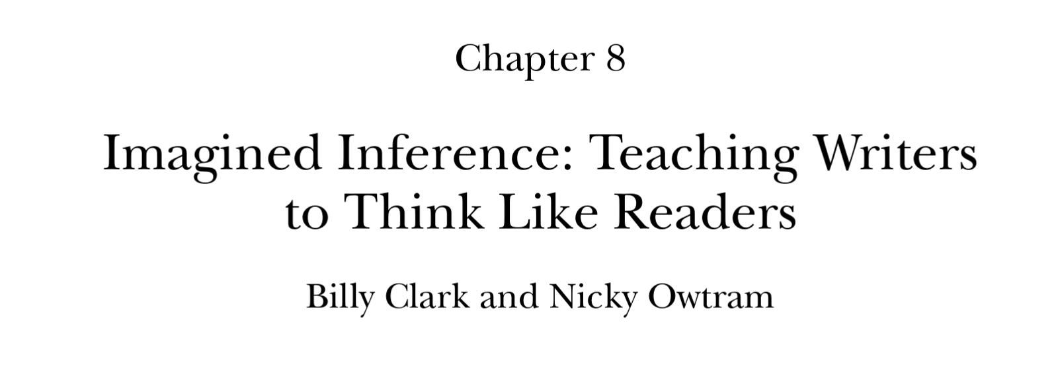
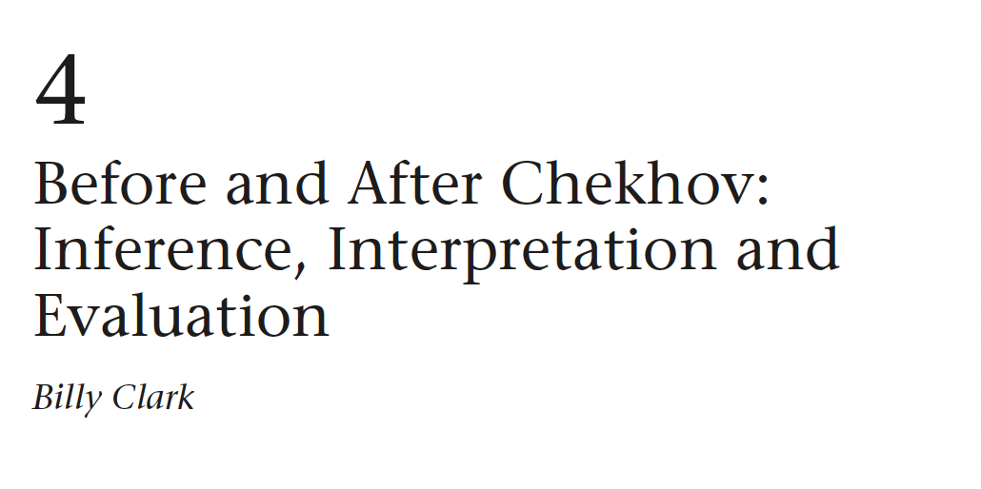
Earlier research and ideas

Slide 18
Production
Grice and other pragmaticists (including Sperber and Wilson and Levinson) talk about what communicators (‘speakers’) do
and this is about imagining how addressees will understand utterances (‘mentalising’/’mindreading’)

Slide 19
Production
Levelt (1989) and others developed cognitive models of production
often mentioning pragmatics but not making specific proposals

Slide 20
Production
Kecskes (2008, 2013, 2014) discussed production, starting from work on intercultural communication
proposed a ’sociocognitive’ model
suggested that ‘egocentrism’ plays a role (alongside Gricean or other pragmatic principles)

Slide 21
Production
Park (2024, Park and Clark 2022, in press) proposed a relevance-theoretic account
assuming a production heuristic similar to the already assumed comprehension heuristic

Slide 22
Production
Clark and Owtram (2012) reported work with students on writing
which focused on considering possible effects on readers

Slide 23
Production
Clark and Williams (in progress) consider writing processes
and how writers talk about writing
considering what kinds of ‘reasoning’ and other processes are involved

Slide 24
Interpretation
fuller accounts have been developed from Grice’s tentative proposals
some (‘neo-Gricean’) assume maxim-like principles
some (‘post-Gricean’) assume different kinds of principles (‘law-like generalisations’ in relevance theory)

Slide 25
Evaluation
van Peer (2008) collection on stylistics and evaluation (not focusing on pragmatics)
Clark (2014) focused on inference and evaluations of a story by Chekhov

Slide 26
Clark (2014) suggests positive evaluation involves:
ease of representation
relevance of effects
‘reward’ for effortful inferences
awareness of responses of others
positive attitudes to formal features and ‘skill’

Slide 27
Grice on inferring meanings
“He has said that p; there is no reason to suppose that he is not observing the maxims, or at least the Cooperative Principle; he could not be doing this unless he thought that q; he knows (and knows that I know that he knows) that I can see that the supposition that he thinks that q is required; he has done nothing to stop me thinking that q; he intends me to think, or is at least willing to allow me to think, that q; and so he has implicated that q.”
(Grice 1989: 31)

Slide 28
But . . .
“We have... a ‘hard way’ of making inferential moves; [a] laborious, step-by-step procedure [which] consumes time and energy... . A substitute for the hard way, the quick way, ... made possible by habituation and intention, is [also] available to us”
(Grice (1979) 2001: 17)

Slide 29
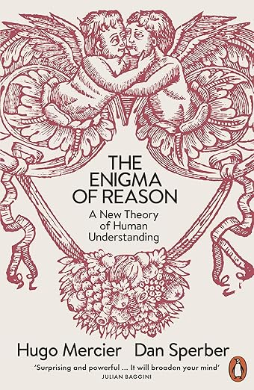
a new view of reasoning
‘interactionist’ (as opposed to ‘intellectualist’ view)
social function (to justify and explain)
‘intuitive inference’ which focuses on reasons
which are generated by unconscious processes

Slide 30
Intuitive inferences
‘conscious conclusions arrived at through unconscious processes’
‘the output of a great variety of inferential modules, the output of which is to some degree conscious while their operations remain unconscious’

Slide 31
Reflective conclusions
conclusions ‘accepted because of higher-order thinking (or “reflection”) about [them]’
‘A reflective conclusion may be an indirect output of a process of intuitive inference. The direct output of this process is an intuitive conclusion about reasons R1, R2, …, Rn for some conclusion . . . the indirect output is the reflective conclusion’

Slide 32
Why did you call the doctor?
Her temperature was a hundred and two

Slide 33
Plan for empirical work
preregistration at Open Science Framework
exploratory research
responses and effects
role play and stimulated recall

Slide 34
exploratory research:
how might you respond in these communicative situations?
responses and effects (with materials developed from above):
binary choices and open responses to communicative situations
questions about effects of responses (given in a)
role play and stimulated recall:
online interactions with researcher (typed responses but some imagining face-to-face interaction)
semi-structured interviews within 48 hours (asking about particular responses)

