Slide 1
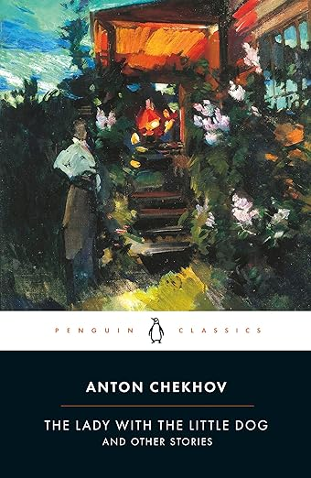
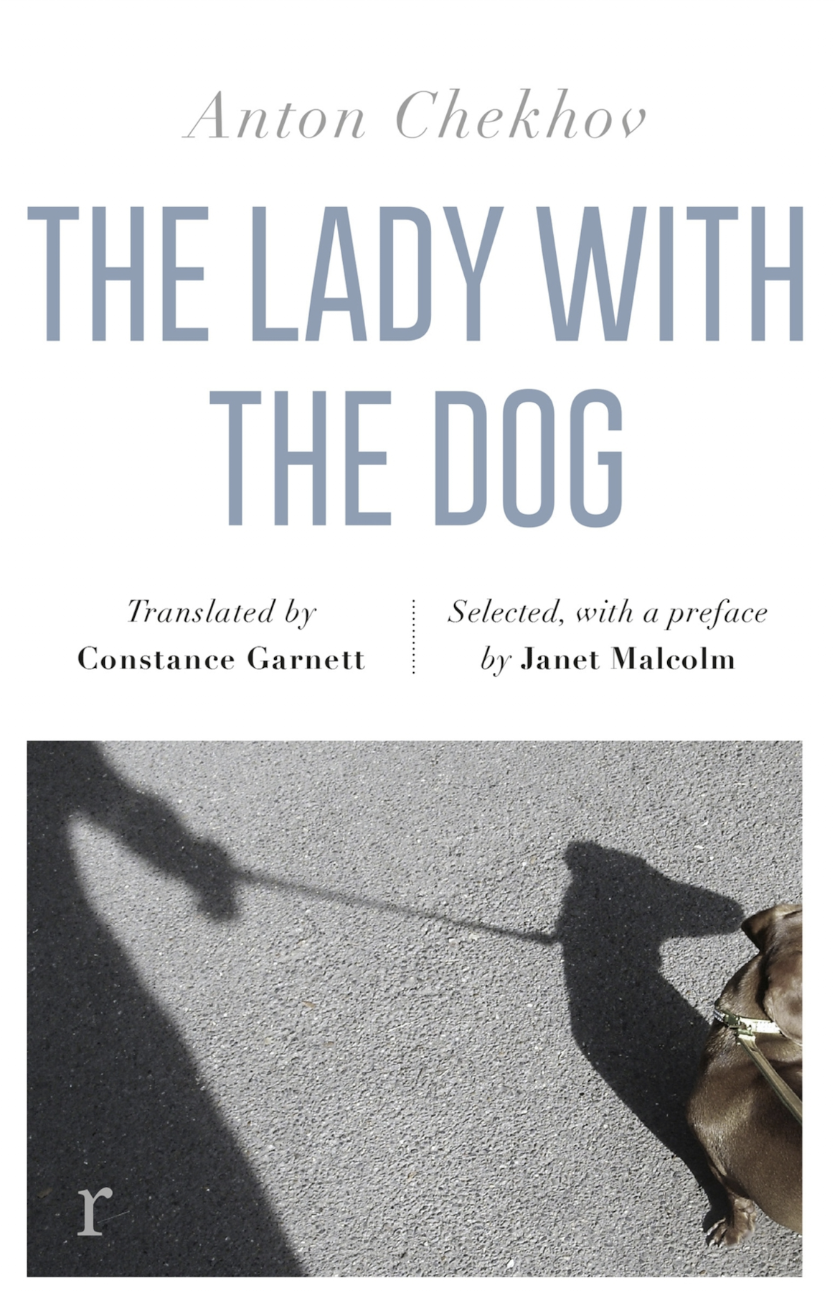
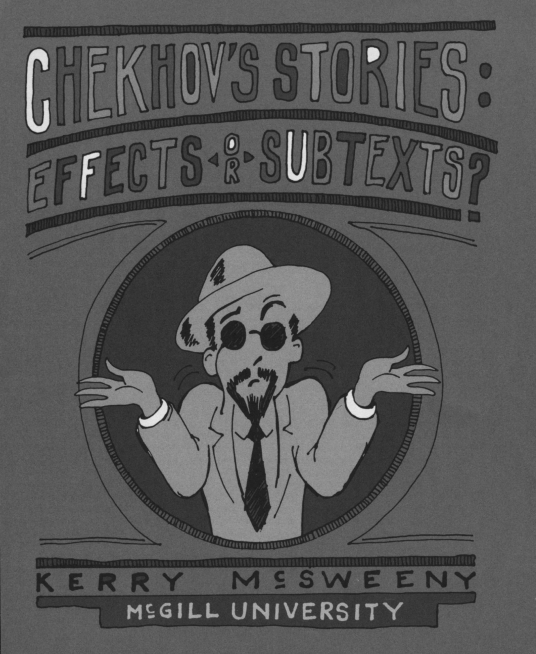


PALA Conference, Uppsala Universiteit, August 2026
A ‘ping’ or a ‘thud’?
pragmatics, reasoning and literary evaluation
Billy Clark, billy.clark@northumbria.ac.uk
Notes:
Start by saying I think ideas about reasoning can help us to understand evaluation
And to understand literary criticism, which involves evaluation (of our own and other people’s ideas)
I also think that looking at evaluation can help to develop ideas about reasoning
But I have a lot questions about it all

Slide 2
PALA Conference, Uppsala Universiteit, August 2026
A ‘ping’ or a ‘thud’?
pragmatics, reasoning and literary evaluation
(including literary criticism)
Billy Clark, billy.clark@northumbria.ac.uk
Notes:
Start by saying I think ideas about reasoning can help us to understand evaluation
And to understand literary criticism, which involves evaluation (of our own and other people’s ideas)
I also think that looking at evaluation can help to develop ideas about reasoning
But I have a lot questions about it all

Slide 3
What do we do when we communicate?
speaking, signing, writing, nonverbal behaviour
we try to understand each other
we make judgments
production
interpretation
evaluation

Slide 4
What do pragmatics and stylistics focus on?
mostly
less (although theories talk about it)
less (although people are interested)
production
interpretation
evaluation

Slide 5
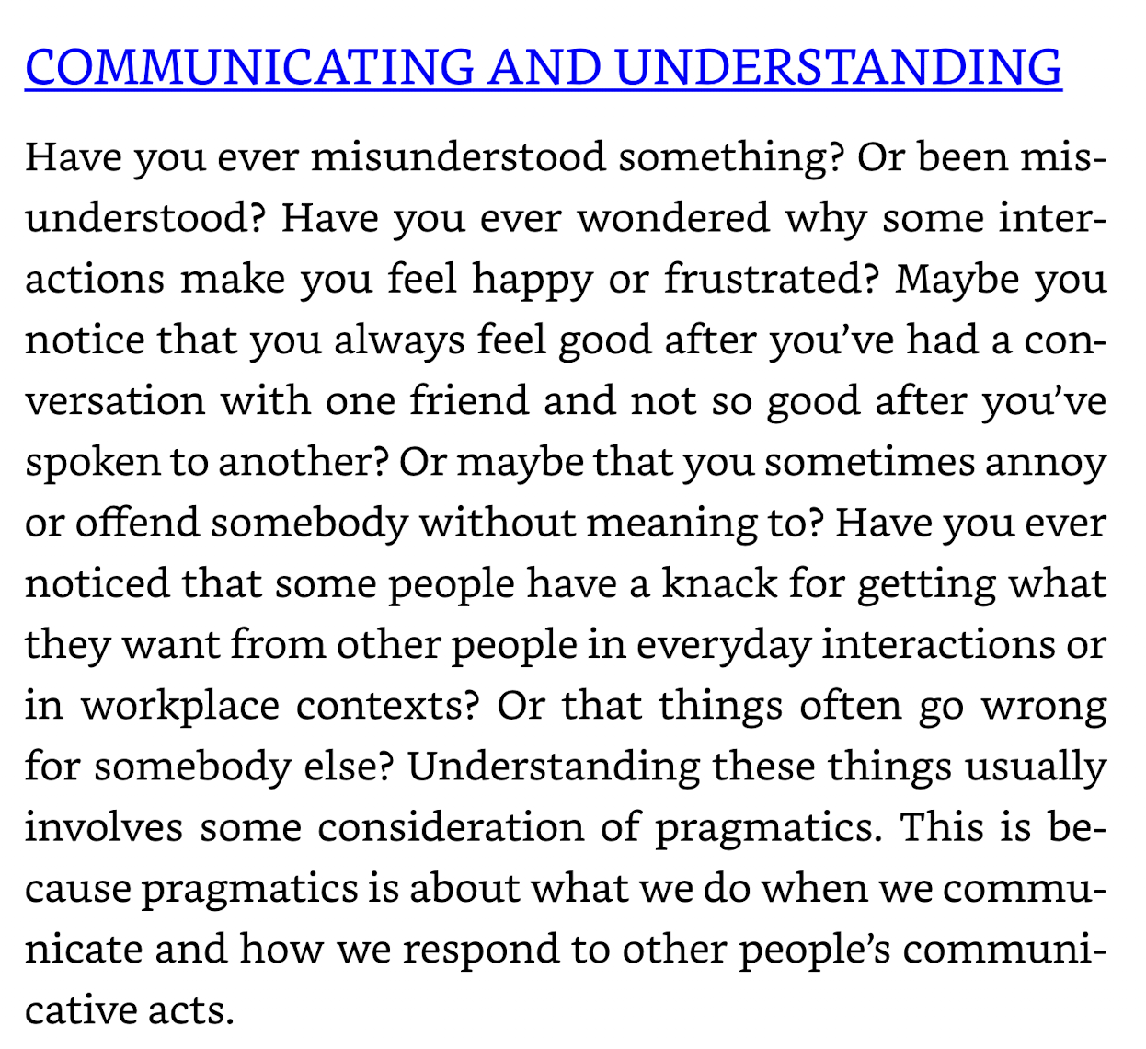
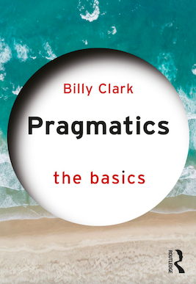

Slide 6
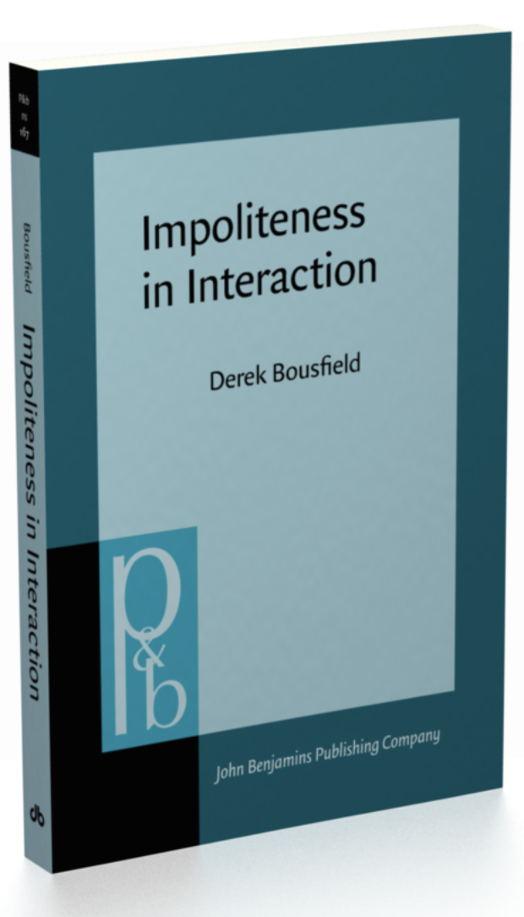
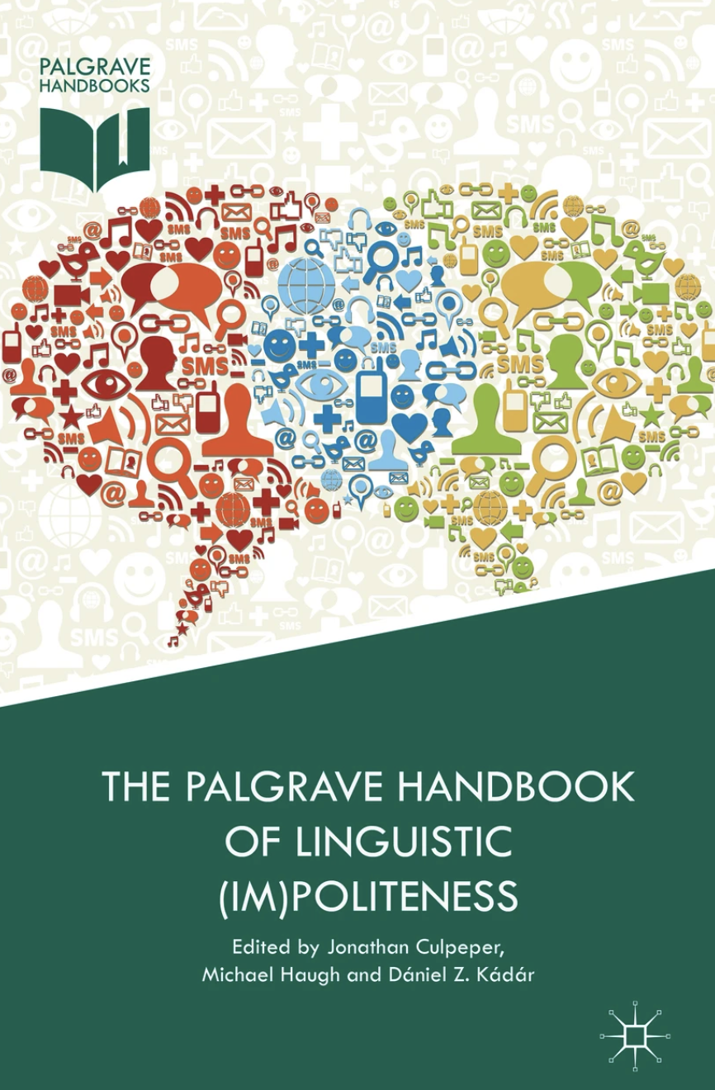

Slide 7
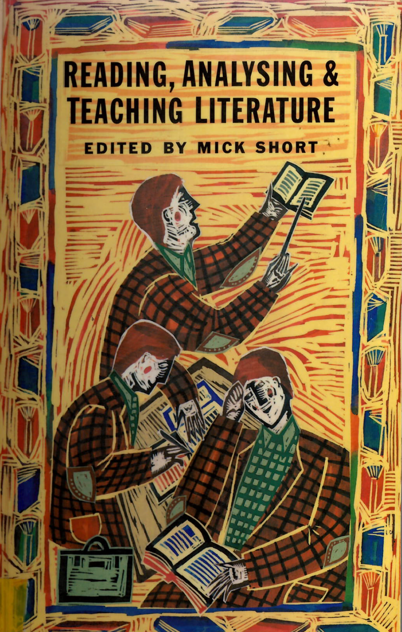
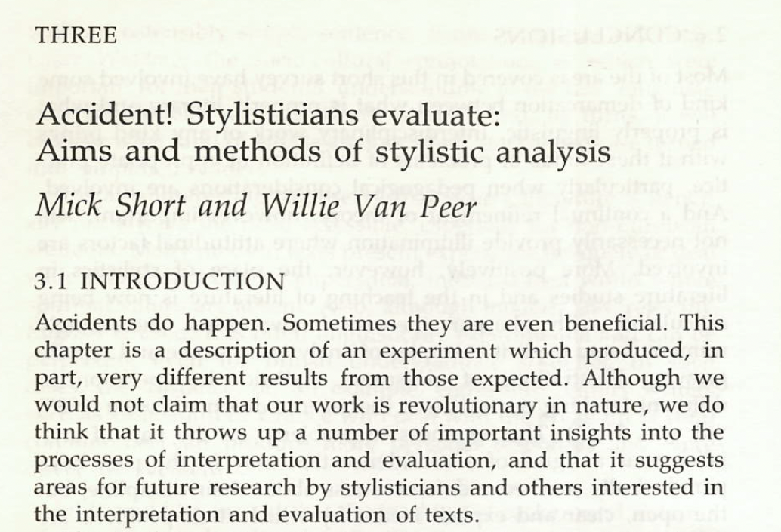

Slide 8
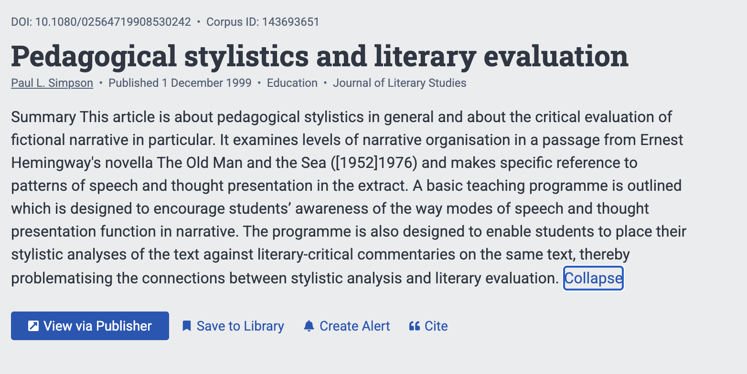

Slide 9
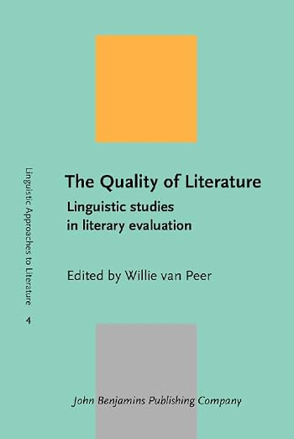
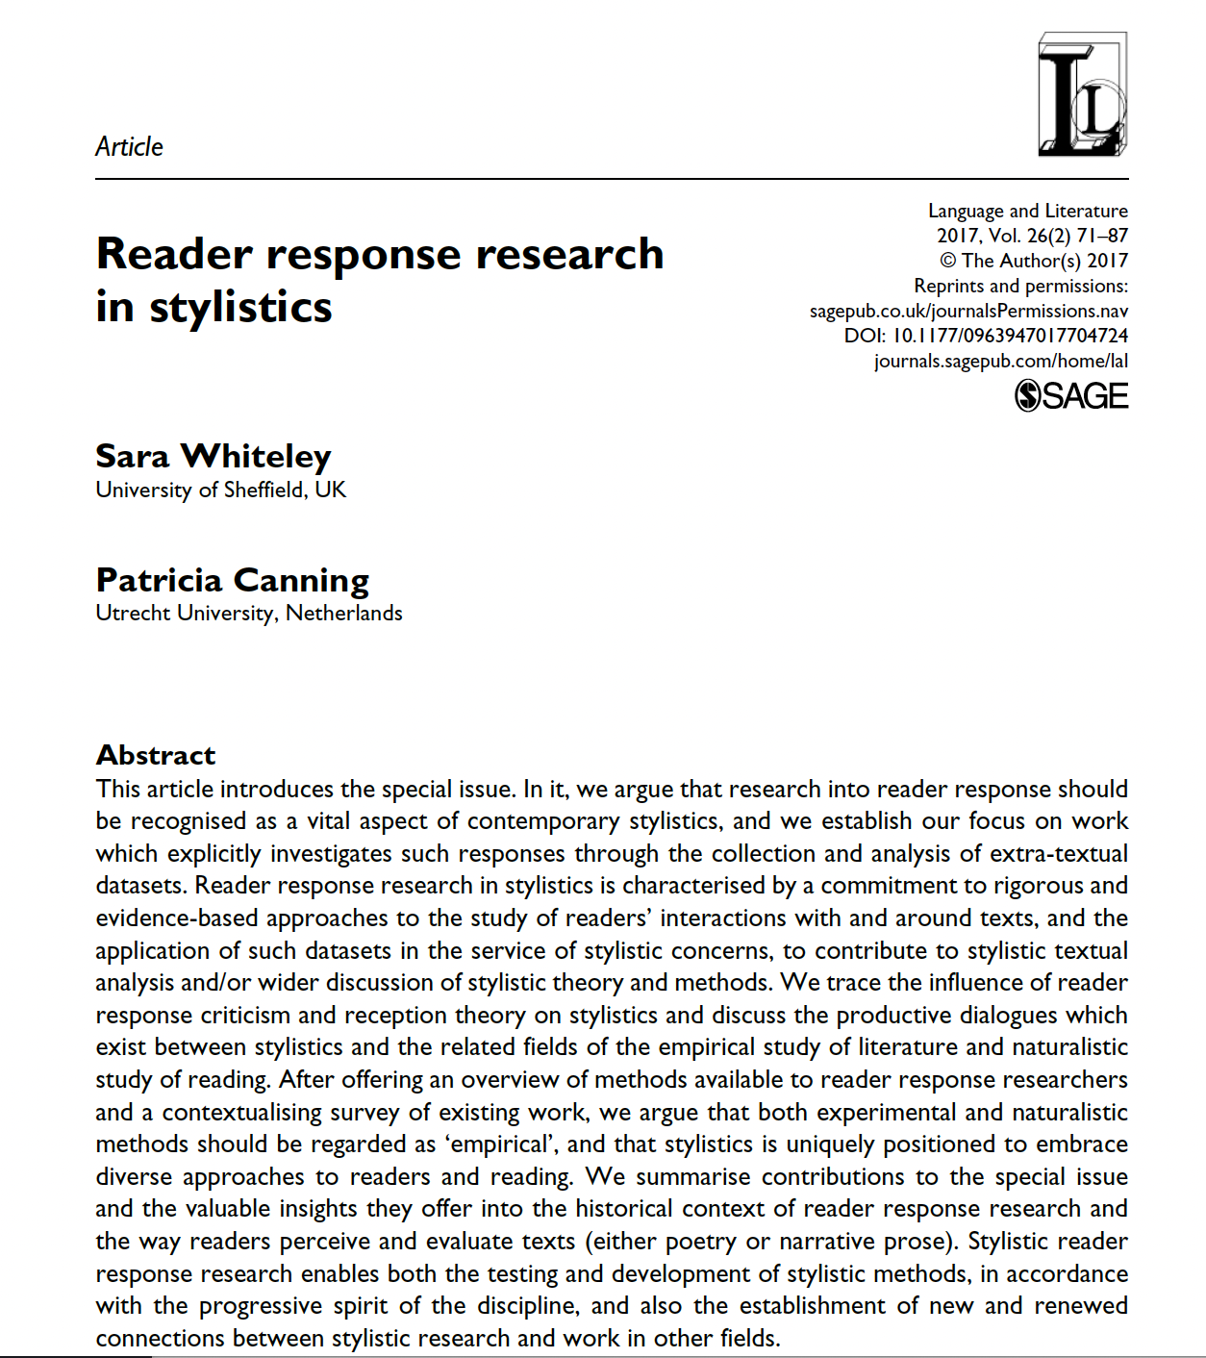

Slide 10
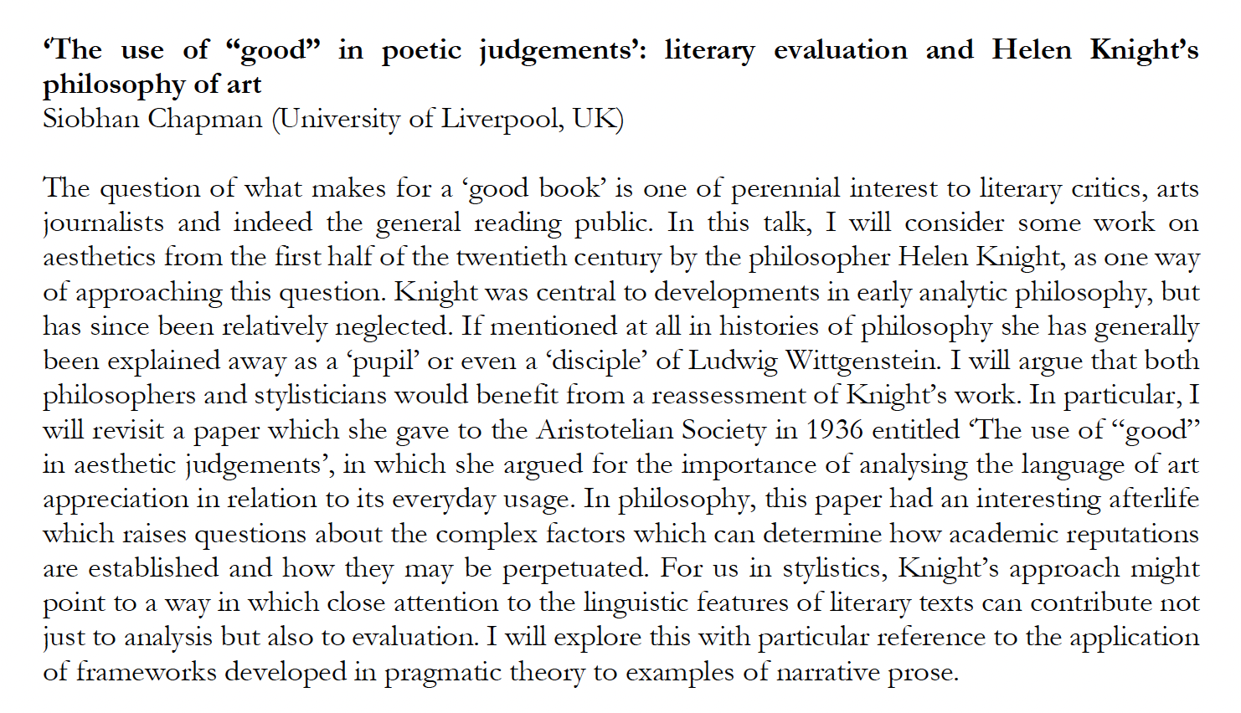

Slide 11
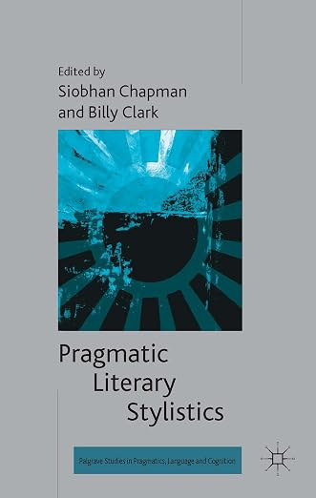
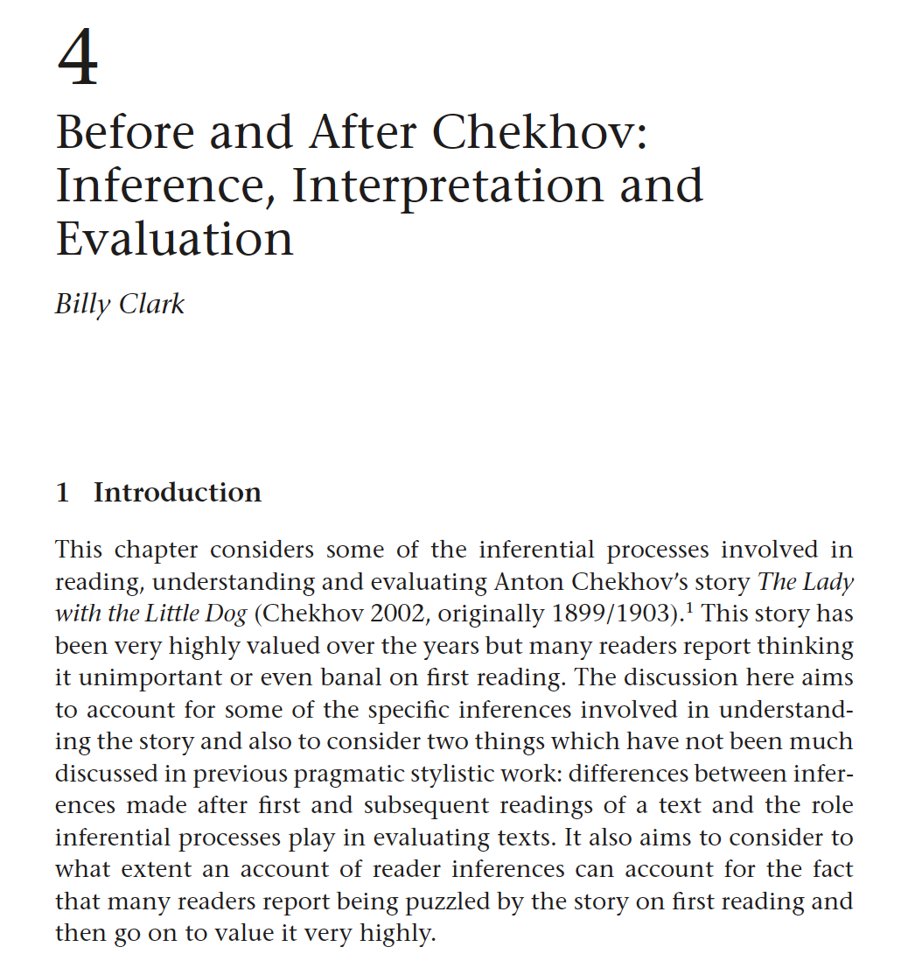
suggestions about positive evaluations
and how they develop after ‘lukewarm’ initial responses

Slide 12
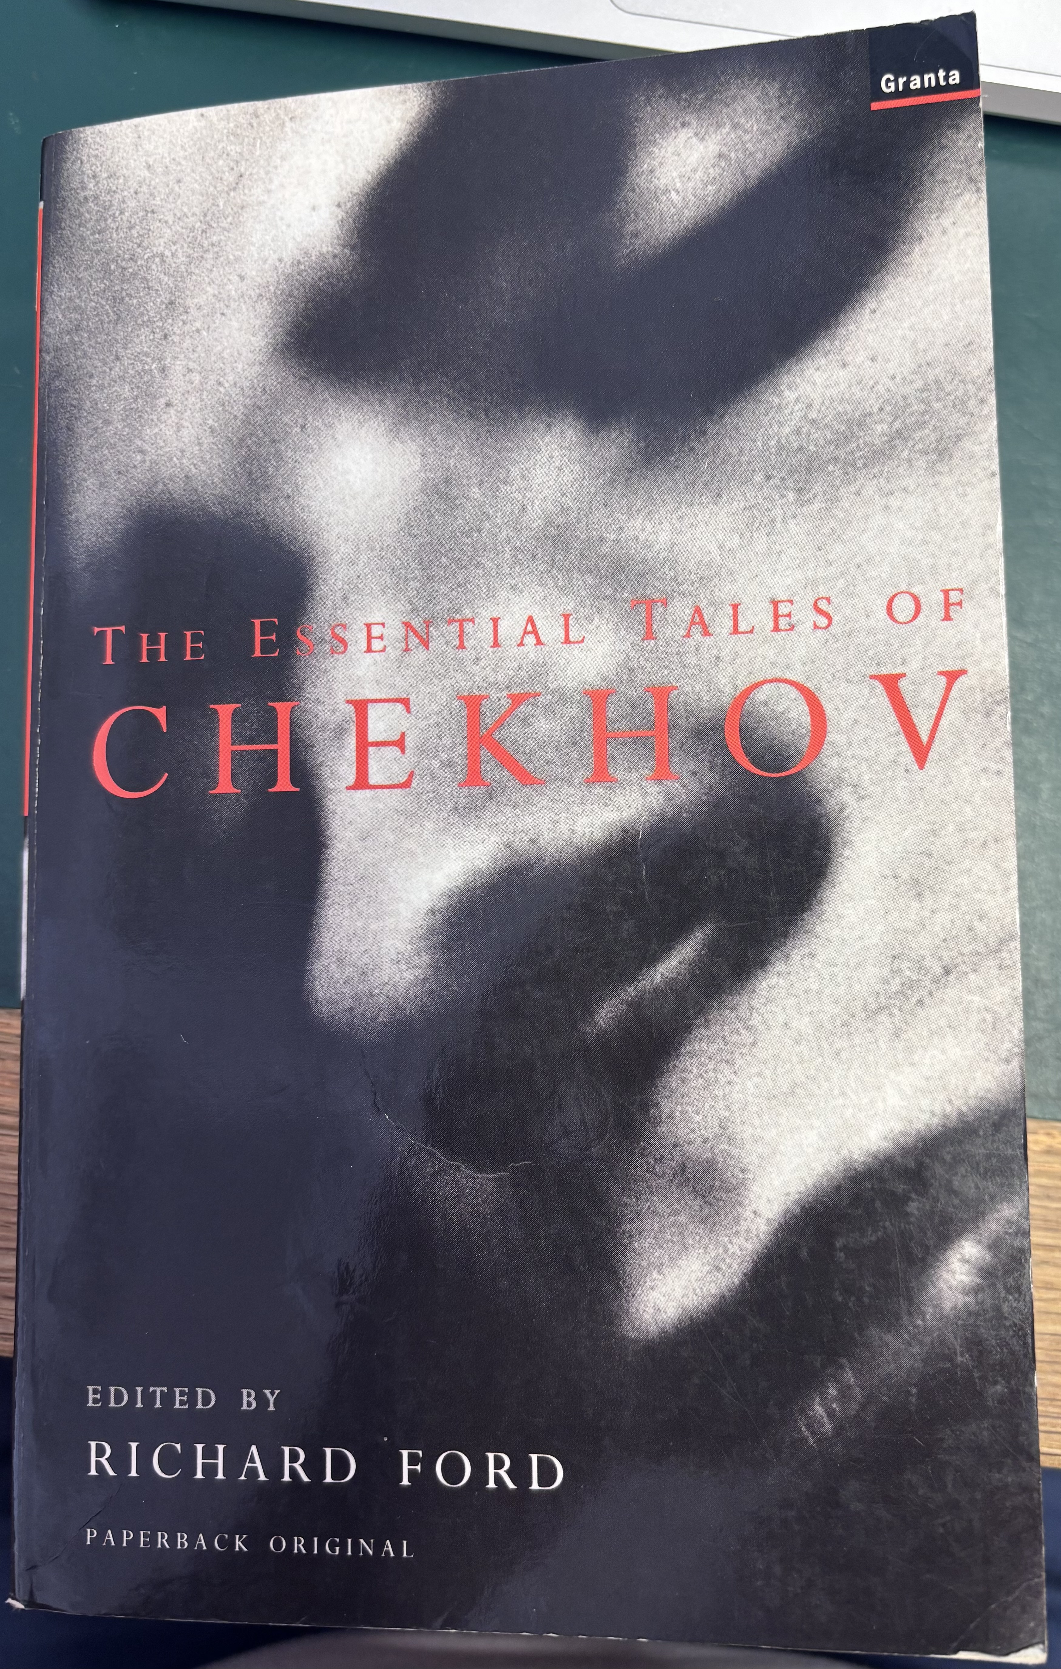
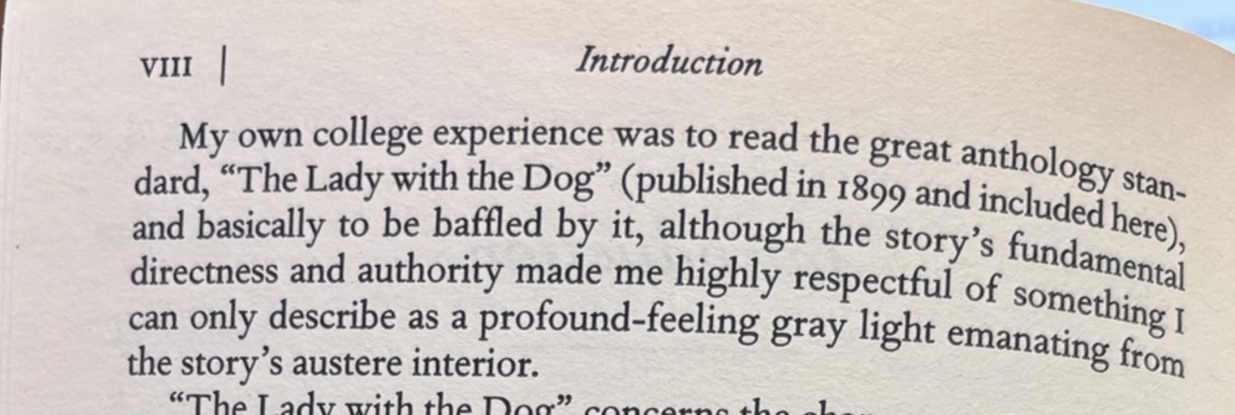
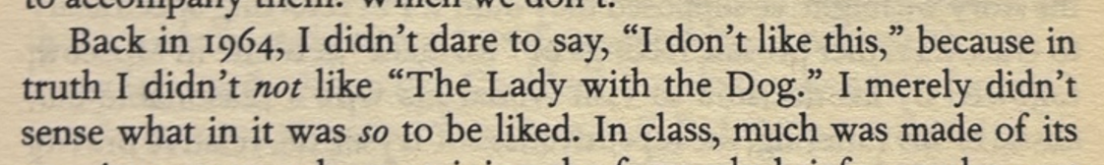
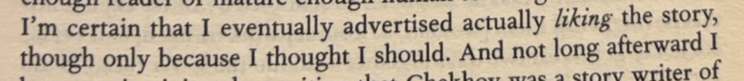

Slide 13
Ideas for what makes evaluations (become) positive
ease of representing parts and whole
relevance of outputs of inferential processes
complexity rewarded by effects
awareness of other people’s responses

Slide 14
What’s involved in literary evaluations?
extended interpretations
extended discourse
reasoning?
can theories of reasoning help?

Slide 15
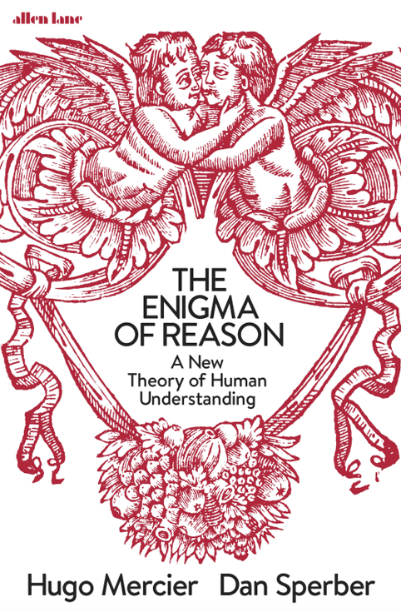
A new(ish) approach to reasoning
an ‘interactionist’ account
social function (to justify and explain)

Slide 16
A new(ish) approach to reasoning
linked to ‘epistemic vigilance’:
being wary of deceitful or incompetent communicators
aiming to appear honest and competent

Slide 17
A new(ish) approach to reasoning
‘intuitive inference’ focusing on reasons
intuitions about reasons generated by unconscious processes (‘X is a reason for Y’)

Slide 18
Why did you call the doctor?
Her temperature was a hundred and two

Slide 19
Why is this story good?
????

Slide 20
Reasoning alone and in groups
solo reasoning is ‘biased and lazy’
we are more careful in assessing other people’s reasons
and we reason better in groups
(and accept good arguments even when we don’t trust the source)

Slide 21
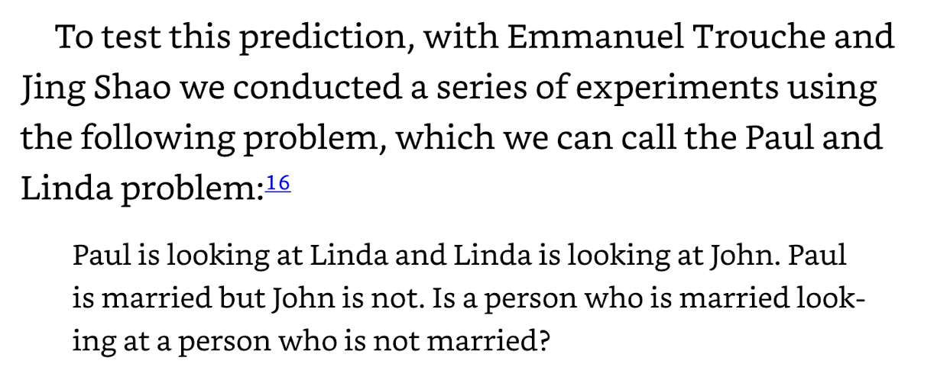
(Mercier and Sperber 2017: 233)

Slide 22
Paul is looking at Linda and Linda is looking at John.
Paul is married but John is not.
Is a person who is married looking at a person who is not?

Slide 23
Reasoning in literary evaluation?
are our own interpretations ‘biased and lazy’?
are we more careful in assessing other people’s interpretations?
are evaluations ‘better in groups’?
do we accept good arguments?

Slide 24
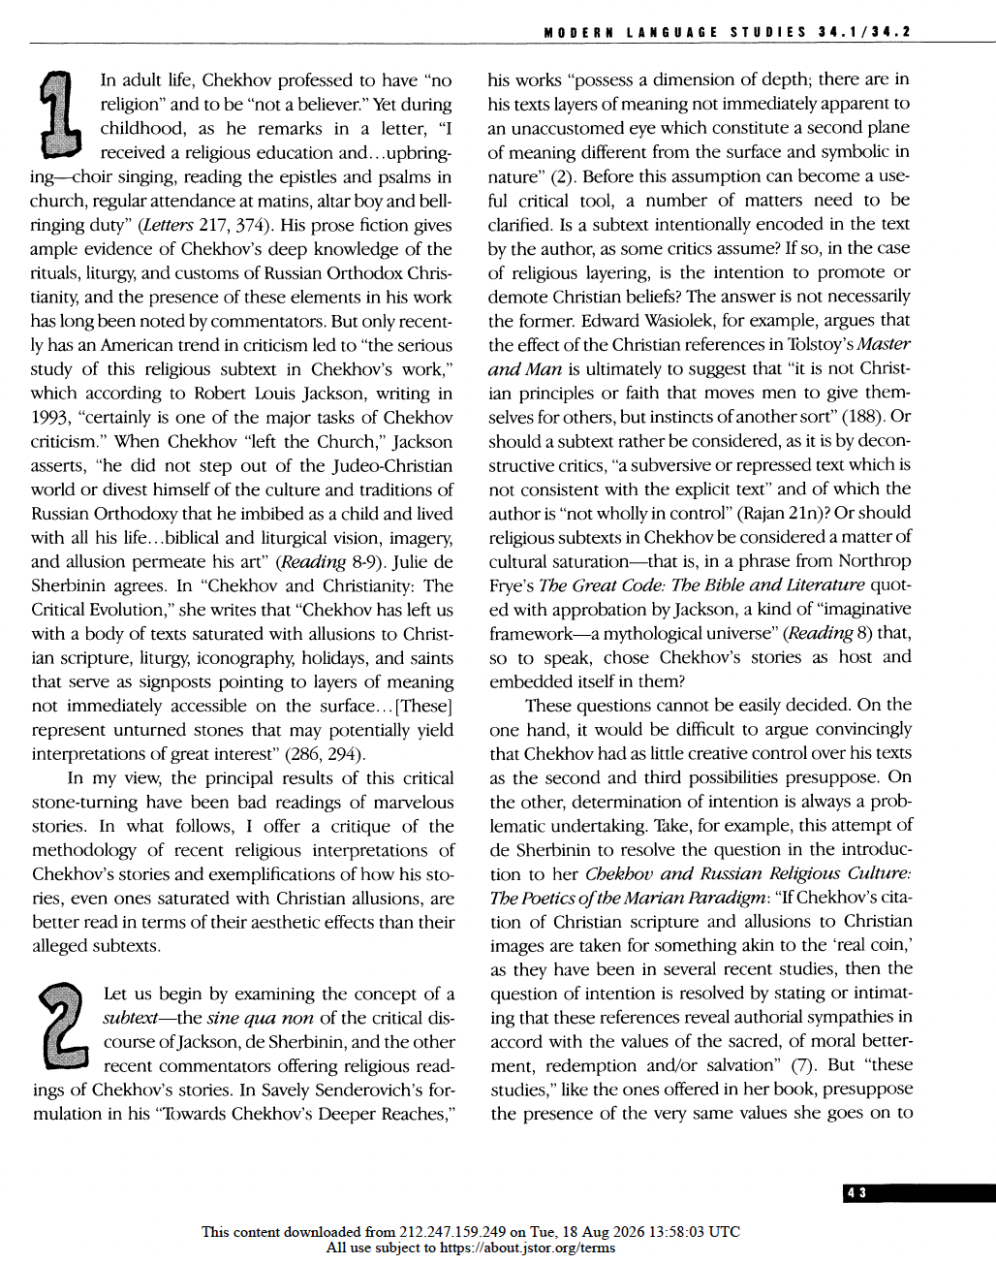

Slide 25
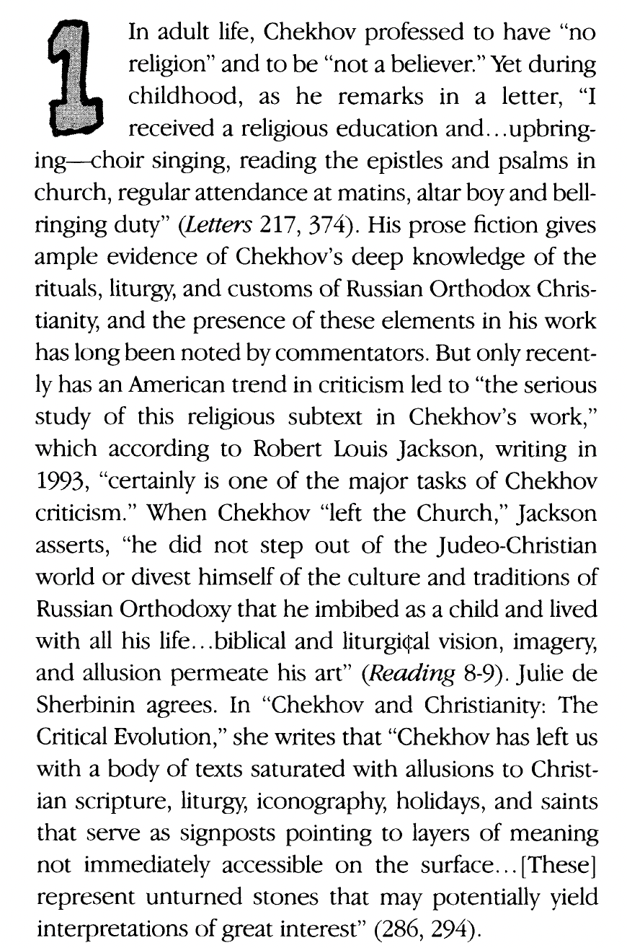
quotes de Sherbinin (1997: 286, 294), saying:
“Chekhov has left us with a body of texts saturated with allusions to Christian scripture, liturgy, iconography, holidays, and saints that serve as signposts pointing to layers of meaning not immediately accessible on the surface... [These]represent unturned stones that may potentially yield interpretations of great interest"

Slide 26
“In my view, the results of this critical stone-turning have been bad readings of marvellous stories . . .
. . . his stories are better read in terms of their aesthetic effects than their alleged subtexts . . .
. . . just because such exegetical operations can be performed on an author’s works does not mean that it is good for them to be so treated”
(McSweeney 2004: 43-44)

Slide 27
Examples discussed by McSweeney
Mihailovic (1993) on ‘Ionych’
(about an inscription over cemetery gates)
Axelrod (1993) on ‘Easter Night’
(about a religious symbolic meaning for the whole story)
Jackson (1993) on ‘The Student’
(about the effect on the main character of telling a Bible story)

Slide 28
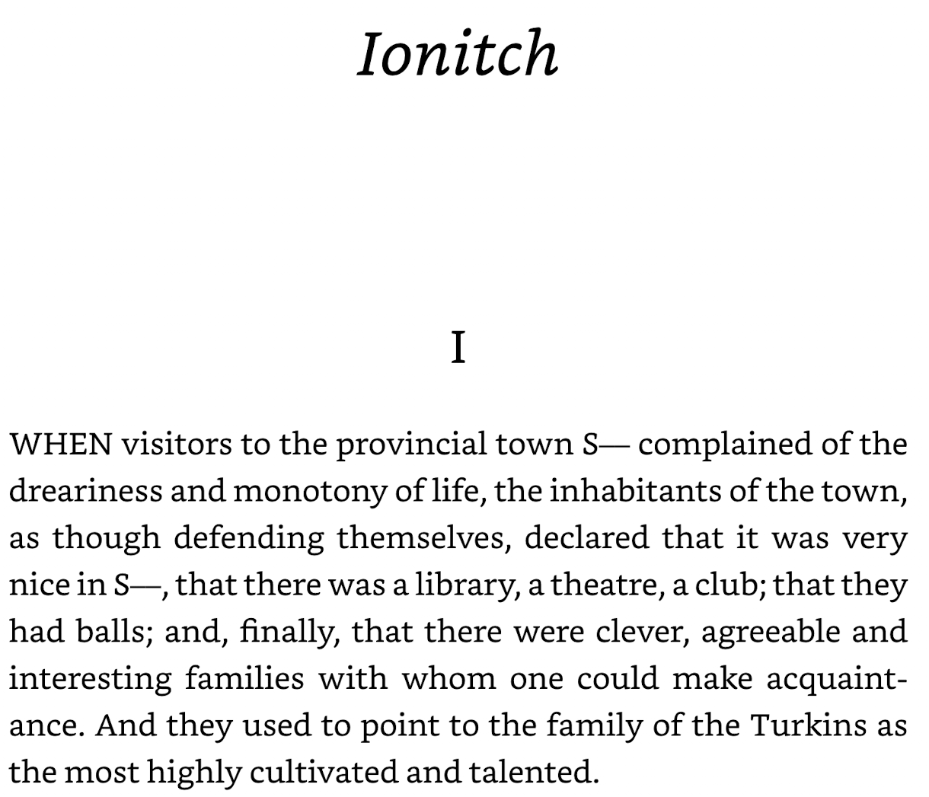

Slide 29
An Inscription (Over Cemetery Gates)
‘Behold the hour is at hand’ (trans. David Margarshack, 1964)
Also translated as:
‘The hour cometh’ (Constance Garnett, 1917)
And as:
‘The hour is coming when . . .’ (Ronald Wilks, 2002)

Slide 30
A ‘ping’ or a ‘thud’?’
McSweeney argues that the inscription is ‘a figural ping’ connecting with several other ideas in the story (foreshadowing disappointment, characters who overdramatise things, theatricality . . .)
She suggests that Mihailovic treats it as ‘a resounding thud . . . nothing less than the centre of “a network of Christological associations and references” (about salvation and life being a matter of choice and not cyclical inevitability)

Slide 31
“The answer seems to me clear: the secular pings are better than the religious thud because they are compatible with each other and in aggregate make for a powerful impression. The inferior interpretation of "Ionych" is the doctrinal one because it is totalizing and smothers the other meanings. It reduces a socially and psychologically penetrating story of a failed life to a Christian cautionary tale.”
(McSweeney 2004: 46)
Notes:
Notice that there is something about overall coherence here
And also that McSweeney’s interpretation makes the story better

Slide 32
Reasoning?
We can consider the role of reasoning at all stages of interpretation and critical discussion
Are evaluators ‘biased and lazy’? Or more critical?
Identity questions: are evaluators aiming to seem ‘competent and reliable’? Or more than this?

Slide 33
Initial interpretations: biased but not lazy?
Readers look for interpretations
As Furlong (1996, 2007, 2011, 2024) suggests, for literary texts, we often go beyond first responses and look for further interpretations (‘non-spontaneous interpretations’)
‘Reading things in’

Slide 34
Assessing other interpretations: not that critical?
Readers often appreciate new insights from others (are they ‘lazy’ in doing this?)
But sometimes they challenge them

Slide 35
Literary critical discussions
Non-spontaneous interpretation
Extending over time
Involve reasoning
Some differences from other kinds of interactional reasoning

Slide 36
Developing a more detailed pragmatic account
Will involve exploring different kinds of implications and implicatures
How they arise in individual reading processes
How they arise in discussions with others
How they are explored and developed over time

Slide 37
THANK YOU!

Slide 38
References
Axelrod, Willa Chamberlain. 1993. Passage from Holy Saturday to Easter Day in 'Holy Night'. 96-102.
Clark, Billy. 2014. Before and after Chekhov. In Siobhan Chapman and Billy Clark (eds. Pragmatic literary stylistics. Palgrave Macmillan: 55-69.
Clark, Billy. 2022. Pragmatics: the basics. Routledge.
Ford, Richard. 1998. Introduction: why we like Chekhov. In Richard Ford (ed.) The essential tales of Chekhov, translated by Constance Garnett. Granta: vii-xx.
Furlong, Anne. 1996. Relevance theory and literary interpretation. PhD thesis, University College London.
Jackson, Robert Louis. 1993. Chekhov's 'The Student’. In Robert Louis Jackson (ed.) Reading Chekhov's Text. Northwestern University Press: 127-33.
McSweeney, Elizabeth. 2004. Chekhov’s stories: effects or subtexts? Modern Language Studies 34.1/2: 42-51.
Mercier, Hugo and Dan Sperber. 2017. The enigma of reason. Penguin.
Mihailovic, Alexander. 1993. Eschatology and entombment in 'Ionych’. In Robert Louis Jackson (ed.) Reading Chekhov's text. Northwestern University Press: 103-14.
Sherbinin, Julie de. 1997. Chekhov and Christianity: the critical evolution. In J. Douglas Clayton (ed.) Chekhov then and now. Peter Lang: 285-99.

